Slide 1
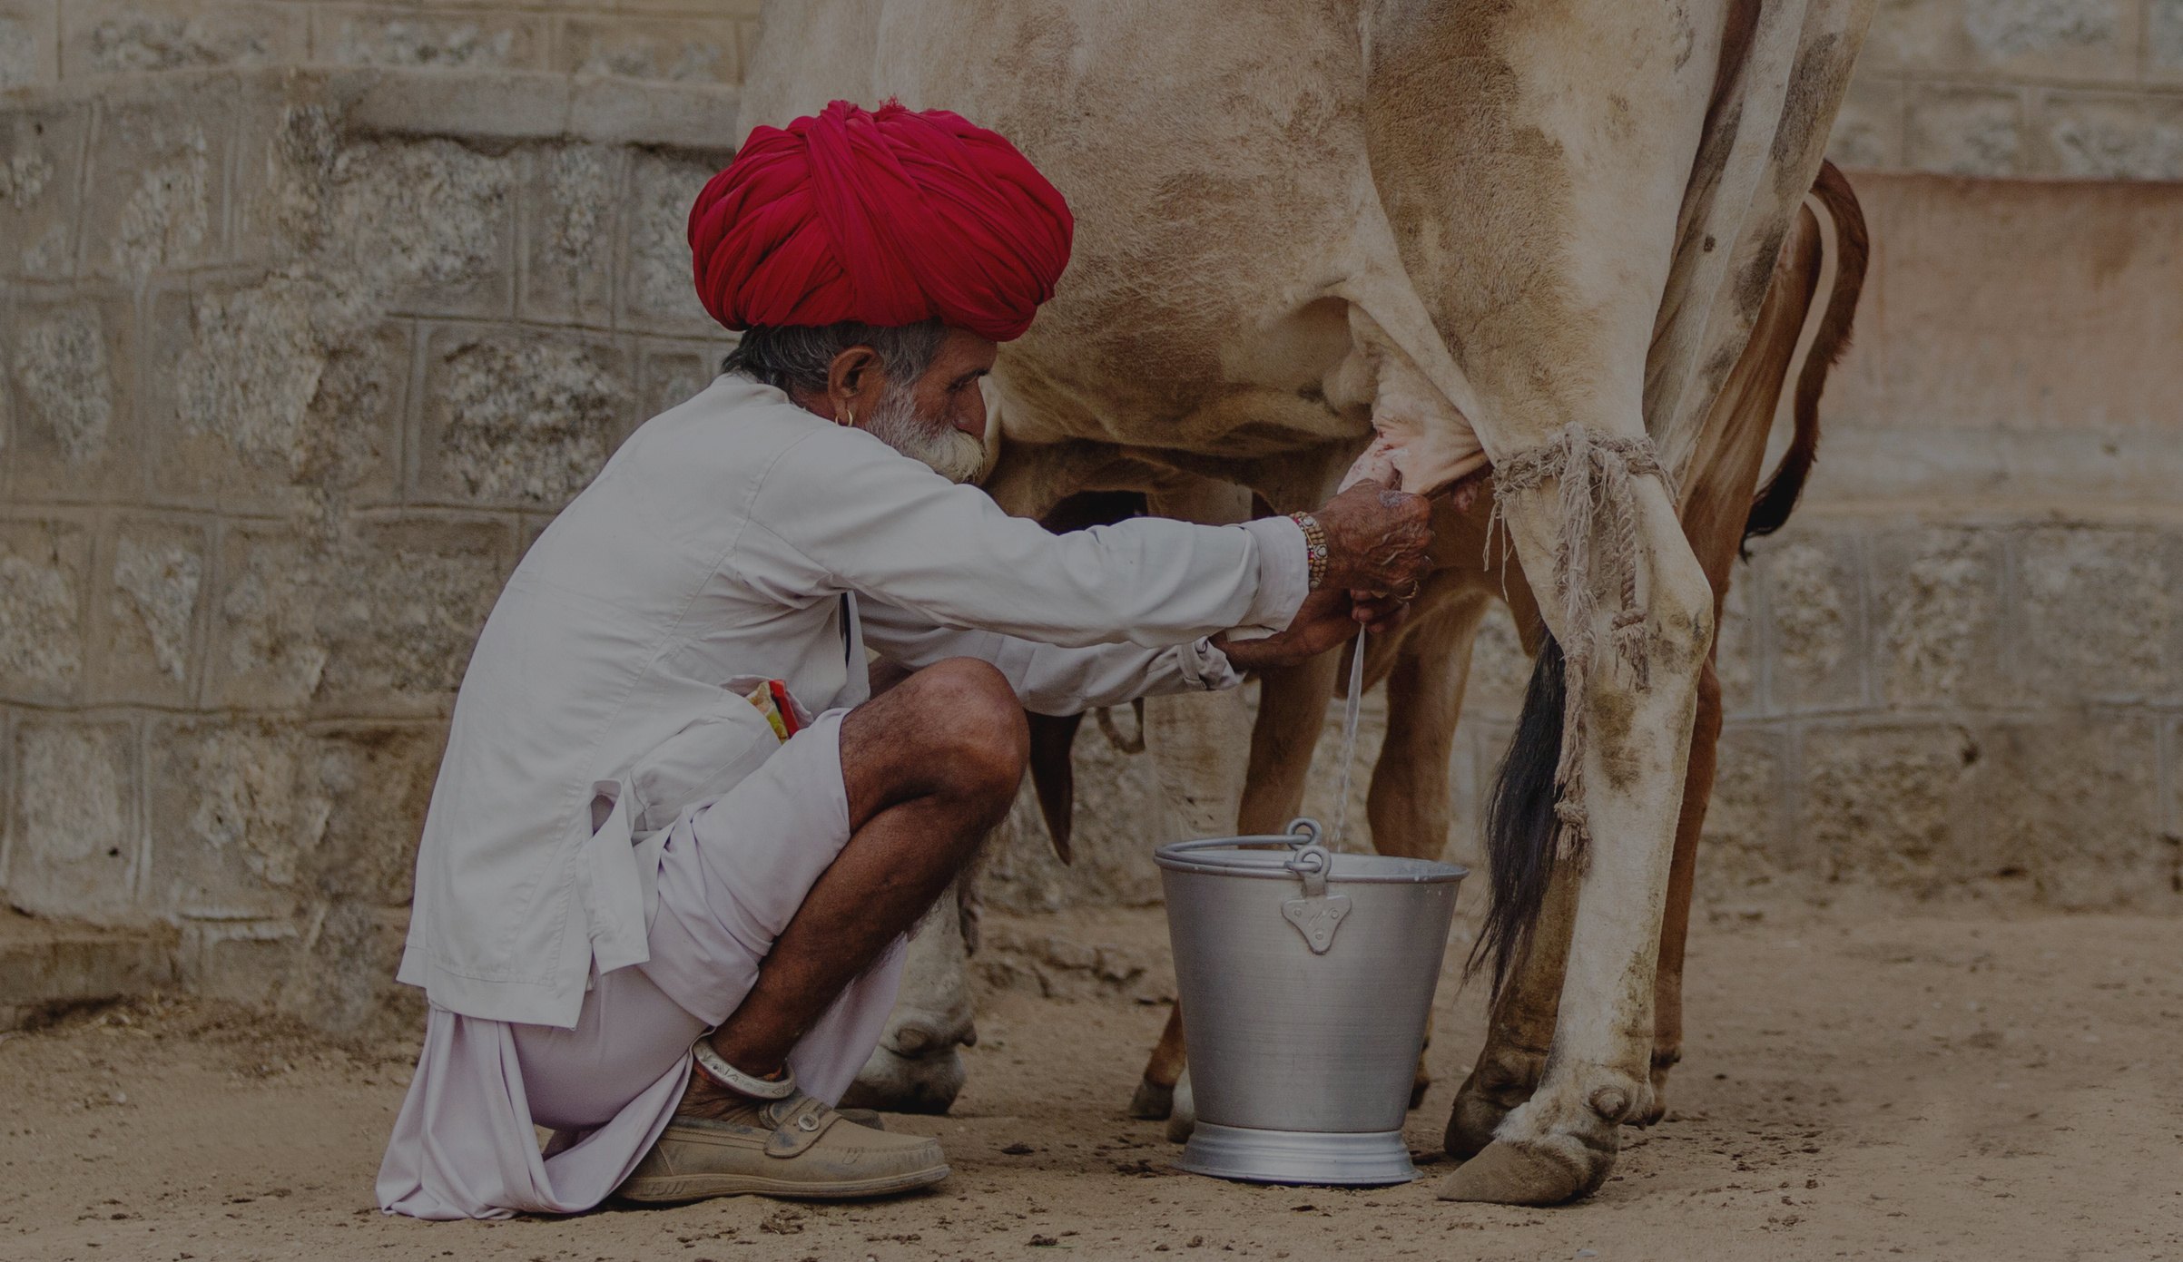
Jordbrukare India
Indian Dairy Outlook
DAIRY OLYMPICS | ALMATY

Slide 2
Industry Snapshot
209
2021*
Milk Production Per Year
CAGR: 4.5%
145B
2021*
Indian Dairy Market
CAGR: 12%
302M
Bovine Population
Cattle : 192 million
Buffalo : 110 million
MT
USD
Heads
Global Rank: 1st
25M
2021
Dairy Imports
335M
106
Per Capita Milk Consumption
2021
Dairy Exports
106 kg/year
Global Rank: 67th
USD
USD
2400
Per Animal Yield
KG/Year
Global Rank: 93rd

Slide 3
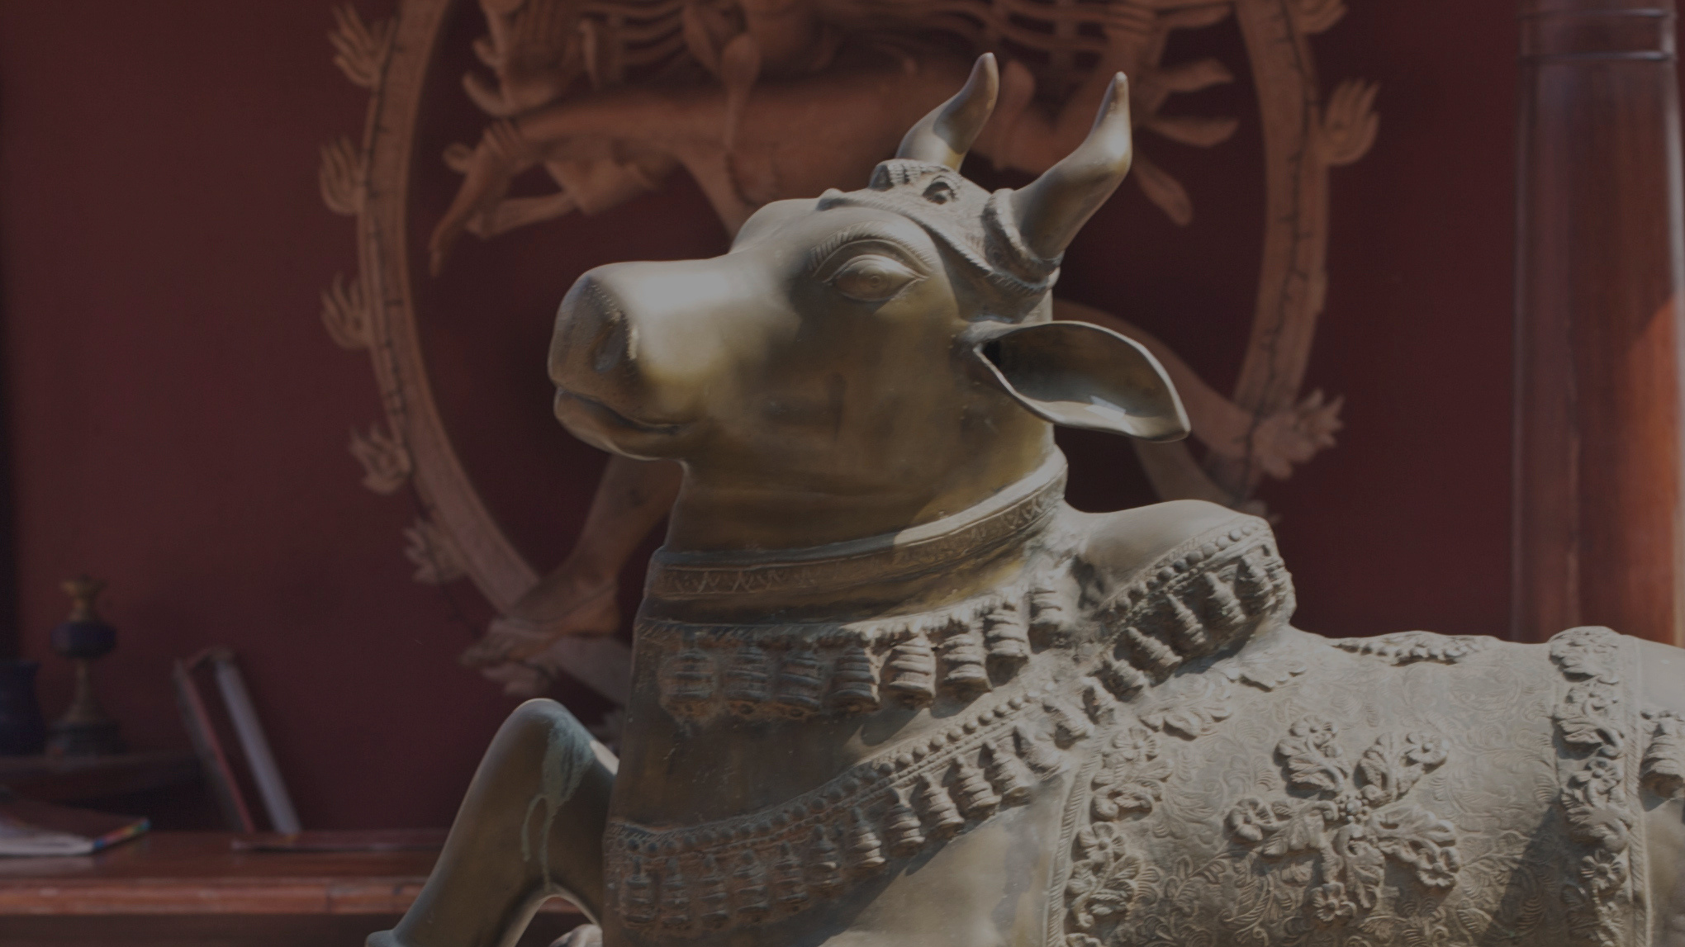

Organization Name
Part 1:
Overview

Slide 4
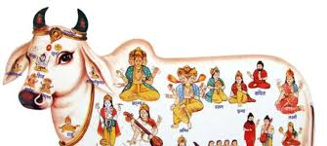
Milk is Culture
Cattle have strong cultural signiﬁcance and milk is a key source for India’s nutritional security
40%
Adhere to a vegetarian diet
82%
of Indian population practice Hinduism
India has an ancient tradition of keeping cattle and producing milk, with many references in ancient Indian manuscripts and literature. Around 1000 BCE, agriculture spread across India. Cows were domesticated to produce bullocks, which were used for ploughing farms. Milk was mainly given to calves and only used for human consumption in the higher-yielding northwest.
In India, cow slaughtering is banned in many states, and beef consumption is limited to the northeast and southern states. Asa
result India is the world's largest exporter of buffalo meat, largely to SE Asia and the Middle East. Major production areas are Uttar Pradesh, Andhra Pradesh, Maharashtra and Punjab. Increased use of farm machinery has reduced the utility of male
calves as animal farm labour is disappearing.

Slide 5
Status Now
Insight
India is the largest milk producer in the world, producing 209 million tonnes or 22% of the world’s annual milk production
Its dairy industry is worth more than 9,168 billion Rupees (USD 144 billion) and contributes 4.2%-5% of India’s GDP. It is India’s largest agricultural commodity, dominated by small and marginal farmers with 1-5 dairy animals on less than 22ha of land
The sector is largely self-sufficient in milk production, with 70 million rural households 3 engaged in milk production, and about 10 million employed full-time in milk production, 71% of which are women.
Milk is an important product in religious ceremonies. Culturally and religiously, dairy is a vital source of protein for the Indian population given it has the 2nd lowest meat consumption per capita in the world. Moreover, there are more than 500 million vegetarians. Given the large rural population involved in the dairy sector, the government takes an active interest in the industry to ensure that initiatives assist and enhance the livelihoods of farmers.

Slide 6
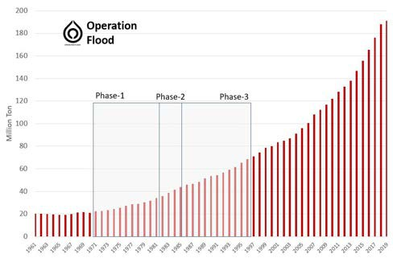
What brought us here: Operation Flood
A key initiative in the development of India’s dairy industry
A key initiative in India’s development was Operation Flood, a rural development programme started by India's National Dairy Development in 1970, which aimed to create a nationwide milk grid. The program was the brainchild of Dr. Verghese Kurien, the ﬁrst chairman of the National Dairy Development Board (NDDB).
Operation Flood & growth of milk production in India, 1971-1997 ⁵
million tonnes
1
pr
Overview
Phase-1 (1970-80): Linked 18 of India's primary milk sheds with consumers in major cities such as Delhi, Kolkata, Mumbai and Chennai.
Phase-2 (1981-85): The concept of a National Milk Grid was launched, increasing to 136 milk sheds.
Phase-3 (1985-1996): Dairy cooperatives expanded and strengthened the infrastructure to produce and market increasing volumes of milk. Cooperatives increased to 73,000 by end of Phase-3.
2 Solution
Operation Flood was instrumental in:
1. Making India the largest milk producer in the world today.
2. Anand Milk Union Limited (AMUL is) emerging as India's largest cooperative milk company.
3. India's National Milk Grid linking milk producers throughout India with consumers in over 700 towns and cities.
Key
outcomes
Average milk procurement increased from 2.56 million kg/day during Phase-1 to
11 million kg/day during Phase-3.
3

Slide 7
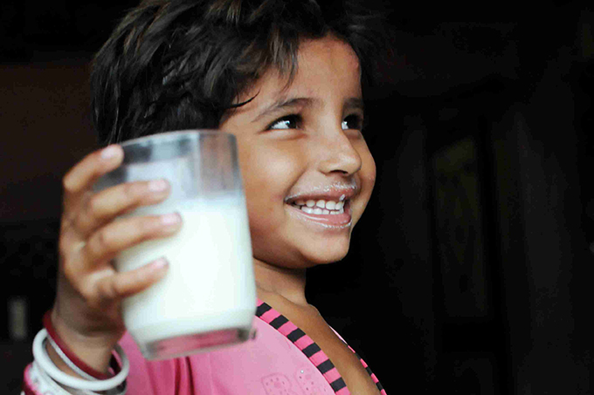
Part 2:
Balance
DATE OF THE REPORT

Slide 8

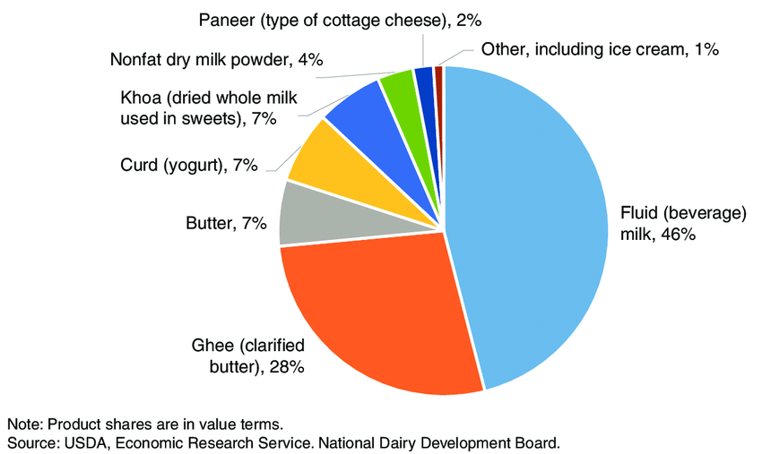
Dairy Products Consumption
India is ranked 8th in the world for fresh milk consumption per capita - over 5X the world average - driven by large vegetarian populations in north & west India
100.7%
Self sufficiency in 2021

Slide 9
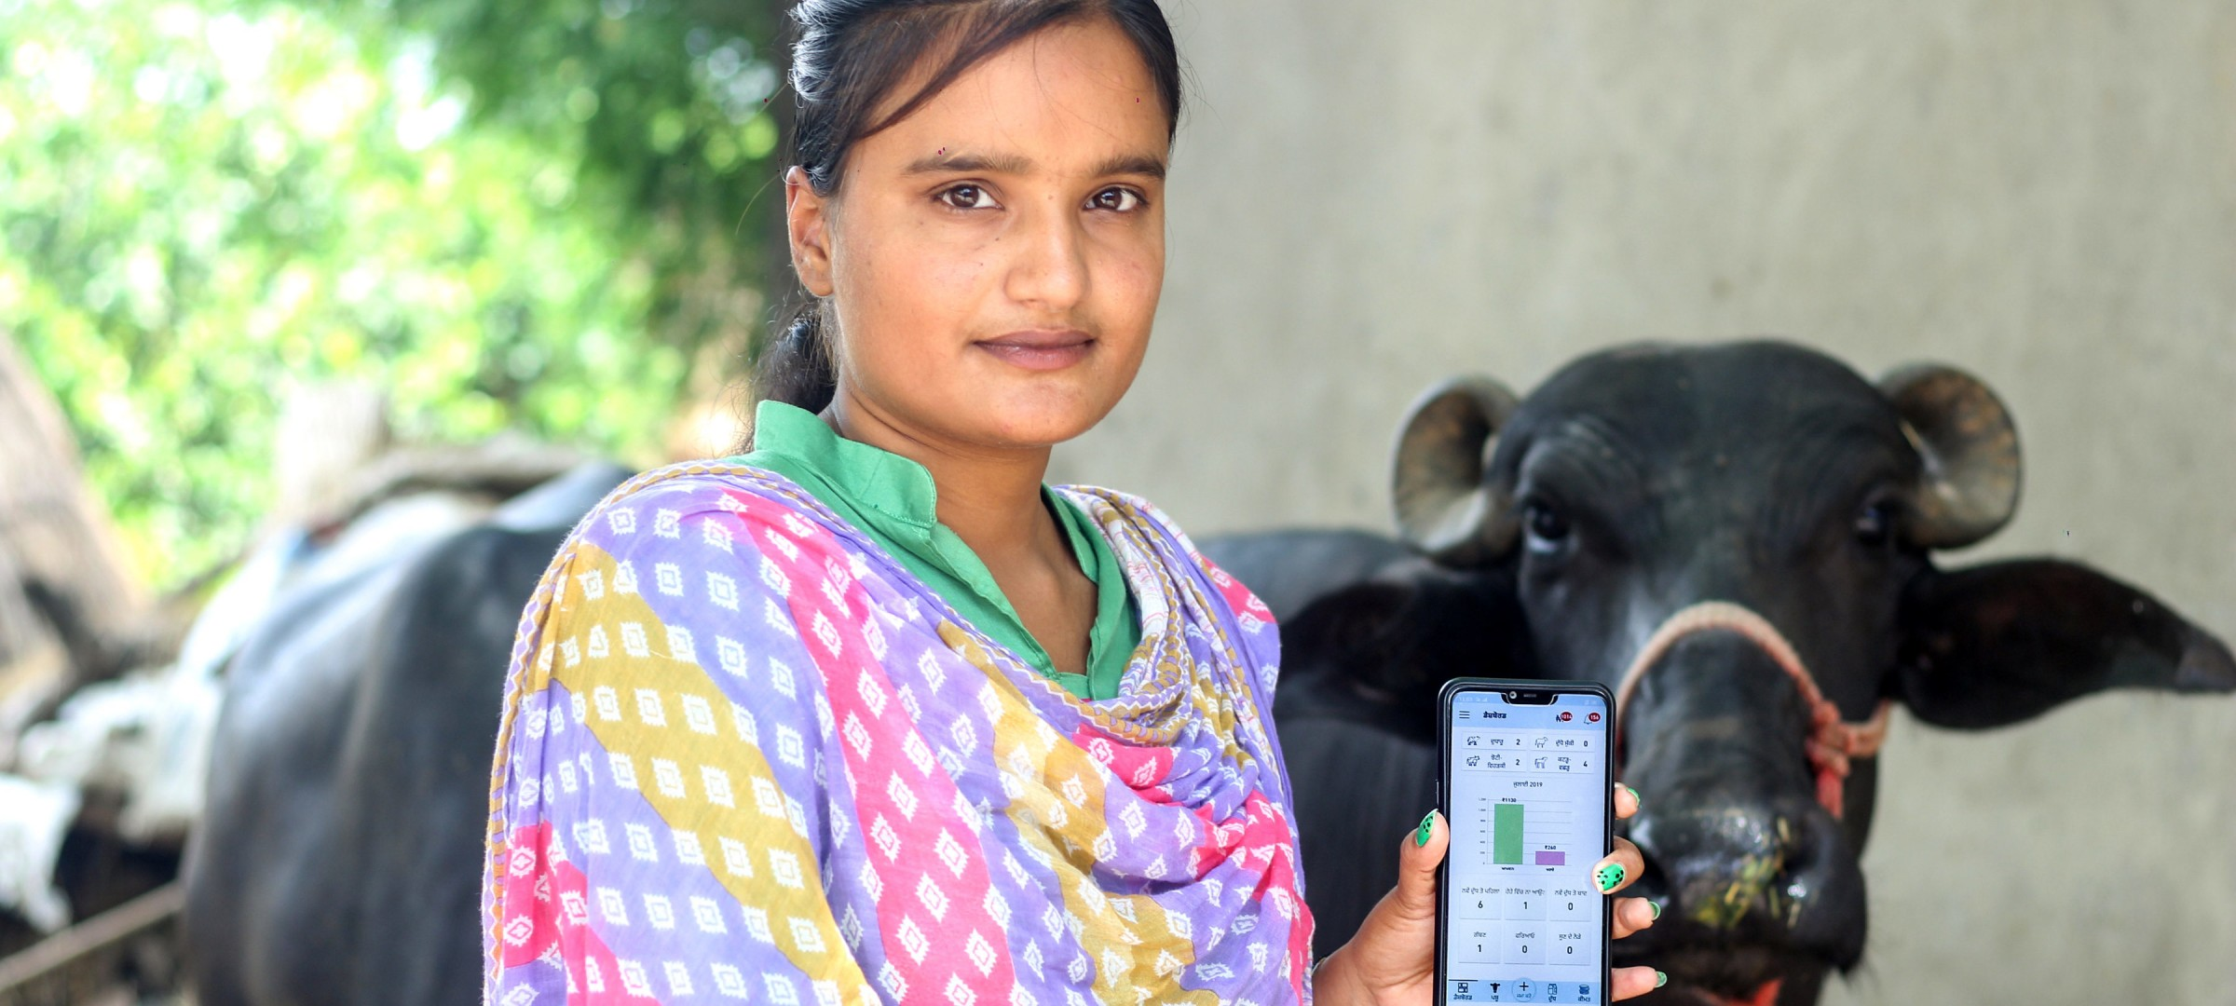
Part 3:
Global Impact

Slide 10
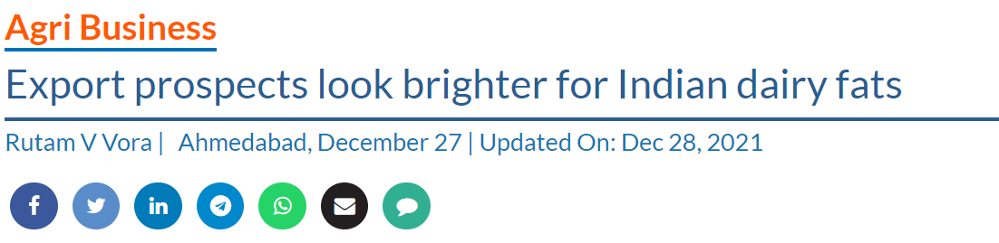
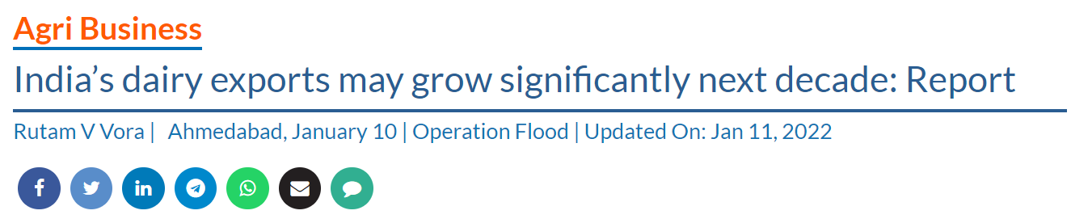
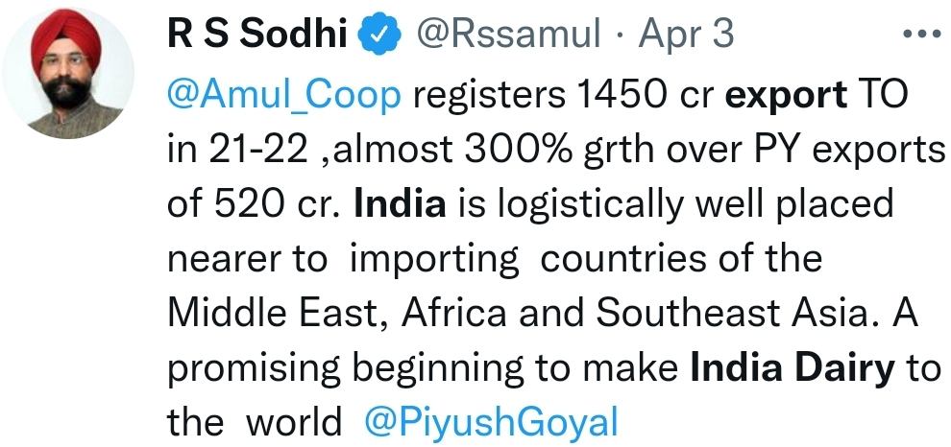
What do we hear?

Slide 11
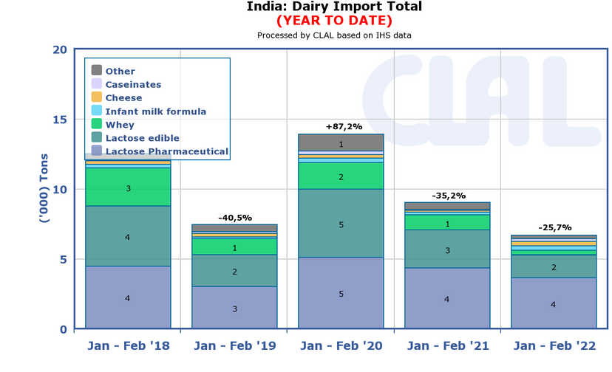
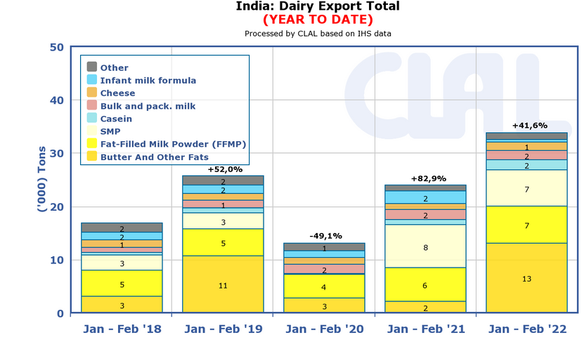
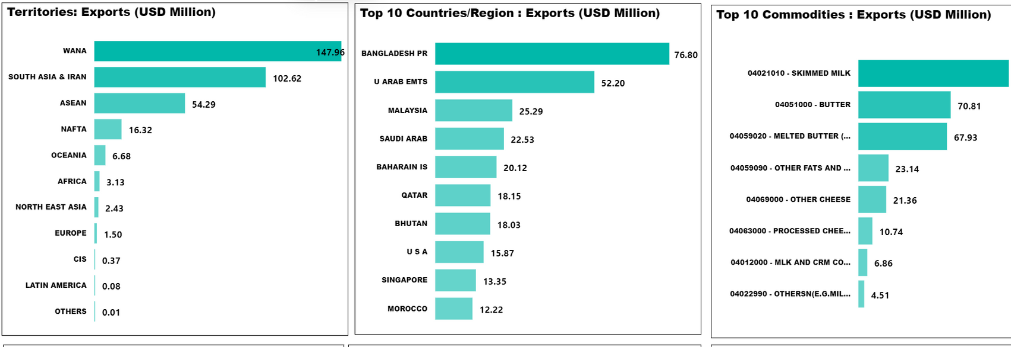
What is being realised?
Source: CLAL
Source: CLAL
Source: GoI Data
Source: GoI Data

Slide 12
What is it happening?

Slide 13

Part 3:
What to expect from the future?

Slide 14
Future Trends
Government initiatives to improve resource utilisation and promote cattle breeding, clean milk production, dairy development, and feed fodder management
GOVERNMENT FOCUS TO 2025
An industry poised for growth
Both the cooperative and private dairy sector is projected to grow at around 14% annually in value in the coming years.
Double dairy processing capacity from 54 to 108 million tonnes by 2025
1. Growth of niche dairy products Rising internet penetration and consumer awareness are shifting consumers’ preferences towards healthier milk alternatives such as camel, goat and donkey milk.
Increase India’s share of global dairy exports from
0.36% to 10%
2. Changing customer sentiments Urban Indian consumers are increasingly quality-sensitive and tech-savvy, adopting new online delivery services for premium milk and packaged milk products.
Ensure availability of quality feed and fodder with door delivery of veterinary services
2. Country is aspiring to be a leading player in the export market but given its limited self-sufficiency, an open market will greatly benefit the country.
US$2b dairy infrastructure fund to promote private investment and increase capacity by 50%
The future of the Indian dairy industry lies in increasing processing capacities and making its dairy
farmers into a cost-efficient and competitive global producer.

Slide 15

Market Intelligence Risk Management Market Access
Contact us if there are any questions.
www.jordbrukare.com
+49 - 1521 3440 815
info@jordbrukare.com
15

