Slide 1
How to support the dairy sector in the global uncertainty
Brazzale Piercristiano
XIII Dairy OlYMPICS,ALMATY
23 MAY 2022

Slide 2
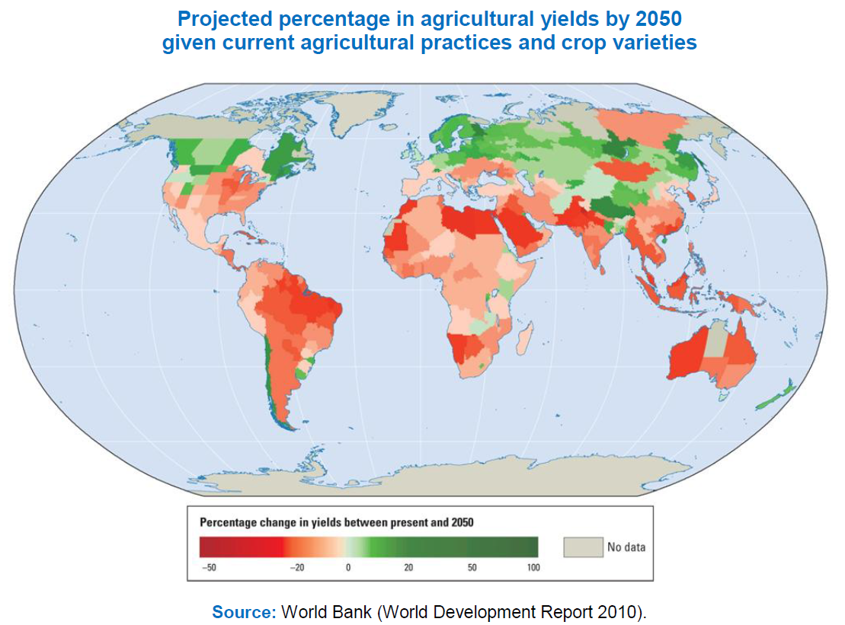


Global key drivers:
Population growth, climate change
By 2050 >9 billion
Projected percentage in agricultural yields by 2050 given current agricultural practices and crop varieties
Percentage change in yield between present and 2050
Source: World Bank (Development Report 2010)
Notes:
More people to feed with limited resources.
The collective challenge is then to produce more food in a sustainable manner. Pressure coming from the civil society (student strikes).
We need to be innovative and efficient.
We also need to address food loss and food waste.

Slide 3
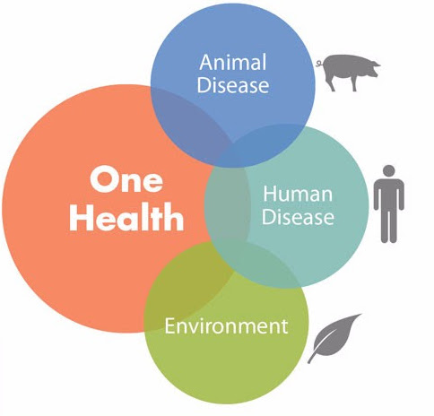
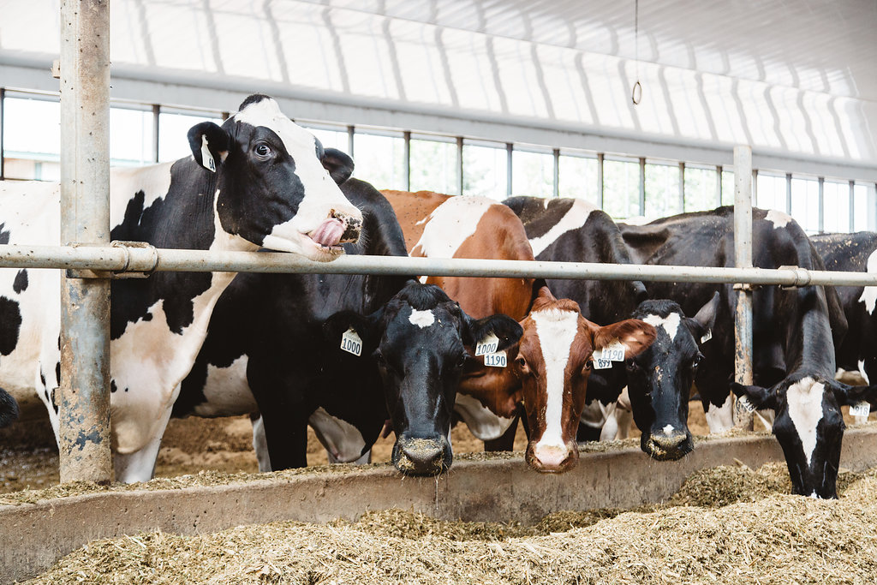
Global key drivers: productive and healthy cattle
One Health
Animal Health and Welfare
Notes:
International governmental organizations such as the FAO, WHO, OIE, Codex are all aligning their work on the ONE Health Approach (which means that there is inter-relations between human health, animal health and the environment). It ensures a coordinated approach on health.
It is then necessary to address animal health and welfare. Not only because we have to but because it also make commercial sense since it improves productivity per animal.

Slide 4
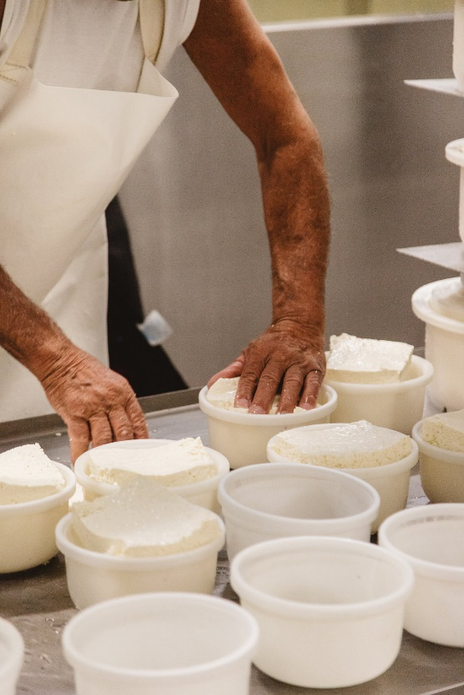
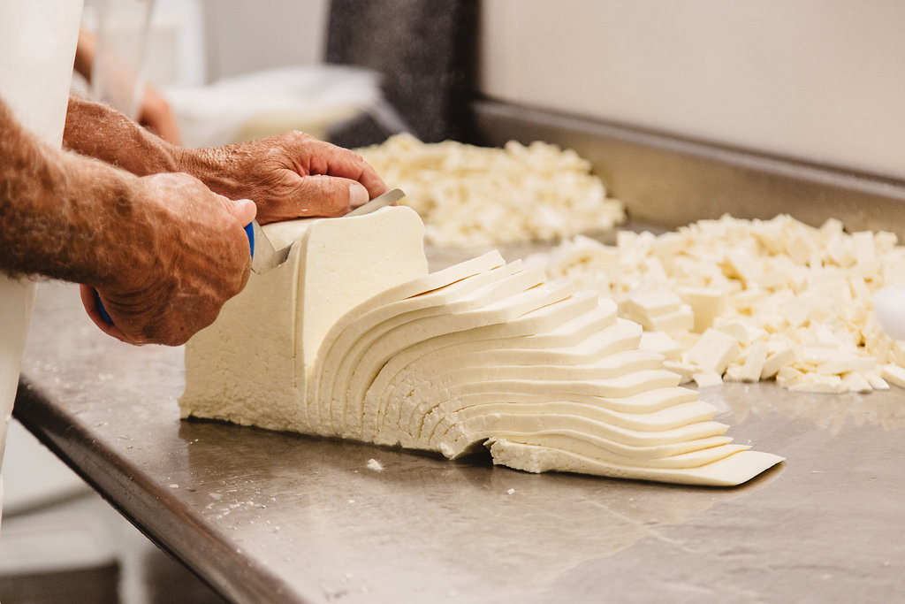
Global key drivers: dairy quality and sustainability
Food Safety & Quality
Sustainable farming, processing, distribution
Notes:
Consumers and governments expect safe and quality products that:
Meet international standards
Are prevented from adulteration (in milk) and food fraud
Access to certain customers nationally, regionally and internationally (e.g. World Food Program) is only possible if you can certify your products.
They also expect sustainable farming and processing: more economic impacts, less negative impact on the environment, more contribution to biomass and biodiversity.

Slide 5
NEW CHALLENGES
How the war will affect our sector ?
Are current conditions the new reality ?
We need to change our approach to the topics of dairy sector?
Do we need to adress something different in our scope of work? Do we need to broaden some topics in our work to support the dairy industry?
New challenges related to the consequences of the war
Shortage of supplies, rising costs, falling consumption, rising inflation, resilience of the dairy sector.
Notes:
The dairy sector had proved resilient during the Covid pandemic, certainly the war came just as it seemed to be recovering.
The crisis in Ukraine comes at a time when global food and feed supplies are already under pressure with low global stocks, soaring prices, weather concerns, high freight rates and the aftermath of COVID-19, and are likely to exacerbate prices on the world market. The Ukraine and Russia are key producers of staple crops including corn and wheat, fertilizers and energy. The real impact of this invasion is not yet known and there are major concerns for next year’s crops and the potential for reduced plantings in key export markets and thus shortages, leading to increased food prices. Russia is also a key player in the energy market. The current conflict has caused energy prices to surge, with negative consequences on the agriculture sector.
. International trade is responsible for feeding 1 in 6 people across the globe and we need to keep trade channels open and to encourage those import dependent countries to build more flexibility into their trade policies, if only on a temporary basis, and without compromising food safety to facilitate trade and keep supply chains moving.
At this point many questions arise.

Slide 6
THE WORLD AFTER THE WAR
Chaotic deglobalisation?If yes what does this mean for?
Milk supply drops due to higher production costs?
Supply chain disruptions?
Inflaction and recession, lower incomes and purchase power of the consumers?
Notes:
We will face a period of self-sufficiency in food production. Is this possible?
Tight milk supply globally, but recession risks is adding pressure on future price developments. The milk price could reach a turning point, but a sharp decline is not expected due to low milk supply, which cannot recover in the short term. Recession risk is coming from three sources: lockdowns in China, energy costs/ geopolitical tensions and inflation ﬁghting rate hikes.

Slide 7
The role of Russia and Ukraine within the global agricultural sector
Participation of Russia and Ukraine in global agricultural production
Participation of Russia and Ukraine in global agricultural exports
Source : FAO Stats
Notes:
In addition to speculative phenomena or due to normal fear related to a war, we really have direct effects on international markets.
Russia and Ukraine are key actors in the global agricultural commerce.
26% of the global grain trade comes from these countries.
All the grains are relevant for livestock diet, especially maize.
From sunflower seed you can obtain pellets that are an important source of protein for cattle.

Slide 9



Impact of the conflict on grain prices
Variation on the on grain prices since February 24
Wheat +19%
Maize +13%
Soybean +5%
Source : Chicago Board of Trade
Notes:
Since February 24, most grain prices increased, led by the international price of wheat which increased 19%. This affects the production costs for farmers and may have a long-term impact on production as well.

Slide 10
Impact of conflict on dairy prices
 | Price March (Usd/t) | Increase in prices (Jan´22 - March´22)
AMF | 7.080 | 19 %
Butter | 7.022 | 16 %
Cheddar | 6.403 | 23 %
SWP | 4.543 | 16 %
WMP | 4.677 | 19 %
Source : Global Dairy Trade
Notes:
The possibility of a lower production for 2022 has an additional impact on the price of dairy products.
This might be positive for farmgate prices, especially in those countries in which have foreign markets as the main destination for their products.

Slide 11
Lessons from the graphs
Russia and Ukraine are key actors within the world agriculture commerce. These two countries are responsible for 26% of global grain trade.
Since February 24, grain prices showed a constant increase, led by the value of wheat which showed a19% growth.
This increase of prices affects production costs for dairy farmers and also impact on long-term production.
Moreover, a decrease in production in 2022 due to a lower availability of grains and fertilizers may have an additional impact on dairy prices as well.

Slide 12
Dairy world 2022:
Dairy demand growth seems to be unlimited while supply growth is limited by skyrocking input prices
Farmers are under pressure today & will be more in the future!
Policy impact will be big –how to predict this well?
Understand market economics to predict the future
“Milk will stay a relevant product in the future” says Richard Scheper from Rabobank at IFCN Conference.
But above all we must make the whole supply chain as efficient as possible both from a technical and economic point of view, meeting the needs of consumers and the market.
Notes:
Key Findings:
-world dairy supply will be short next years,2022 ca. 1%
-farmers are under huge stress due to cost of production and stopping investments especially in EU
-mega trends need to be monitored with good quality data to understand that demand is overcoming supply much faster that we thought
-war i. Ukraine just accellerated need of a change how do we produce food in the world.
Main question:who can offset EU net export loss in the future?and produce milk with affordable prices for emerging countries?

Slide 13
PRIORITIES FOR THE DAIRY SECTOR
Efficiency, efficiency, efficiency, in term of increasing production and saving costs.
Sustainable intensification of agriculture(last IPCC report)
Regenerative agriculture
Animal welfare
Carbon neutrality;
Human rights/living conditions/economical sustainability of the dairy chain

Slide 14
IDF SUPPORTING THE
Global Dairy SECTOR
INTERNATIONAL DAIRY FEDERATION

Slide 15

What is the IDF?
Established in 1903
Members in 43 countries representing 75% of world milk production
1,200 experts working in 17 Standing Committees and 3 Task Forces
Accredited to the FAO, Codex, OIE, UNEP, ECOSOC
Notes:
IDF is one of the oldest international organizations which was created in 1903 to set standards on milk and milk products.
We have 43 member countries, including Canada.
We are a network of dairy experts.

Slide 16
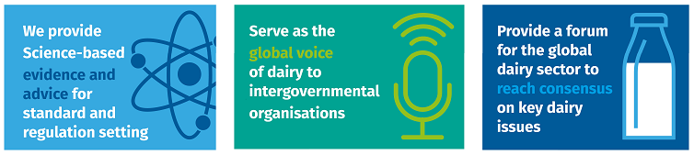
IDF in brief
Our mission: To help nourish the world with safe and sustainable dairy.
Notes:
Our mission is to help the world with safe and sustainable dairy.
Our roles to:

Slide 17
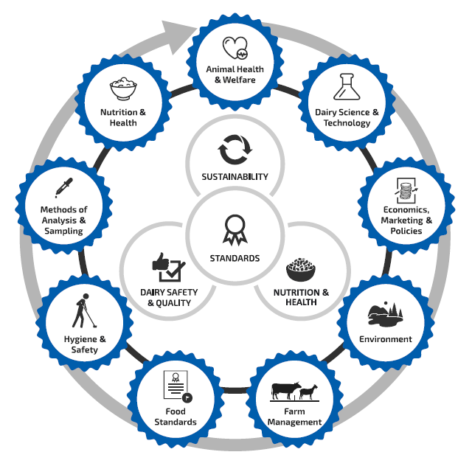
Idf working areas
1,200 experts covering nine areas of work

Slide 18
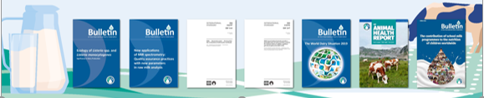
Idf programme of work delivered LAST YEAR
5 Bulletins
The World Dairy Situation 2021
Ecology of Listeria in Dairy Production
Global Marketing Trends, Understanding changes in dairy consumption around the world
Applications of MIR spectrometry: Quality assurance practices
The contribution of school milk programmes to the nutrition of children worldwide – Edition 2020
6 Joint IDF/ISO standards
27 submissions to IGOs
8 Position papers
Impacts of COVID-19 on food security and nutrition:
Lactose, an important nutrient
Sustainable healthy diets: balance between plant and animal-source foods
Front of Pack Nutrition Labelling - Delivering meaningful public health outcomes
Nutrition Profiling Models:
3 reports
IDF Dairy Sustainability Outlook
IDF Animal Health Report
7 Factsheets
Reproductive Technology
Dairy’s role in supporting a healthy immune system
Lactose
Technical Webinars
We organized and continue to orgaganize webinars on a broad range of topics for IDF experts.
Notes:
IDF produces: Bulletins, Reports, Fact sheets, Position Papers, Submissions to IGOs, IDF-ISO standards and IDF Technical Webinars Series.

Slide 19







IDF Methods of Analysis are accepted by IGOs
The methods developed by IDF, jointly with ISO, are accepted by all key organizations
IDF is currently working on approximately 100 standards for methods including:
  Protein in dairy products
  Nutrients in Infant Formula, in collaboration with AOAC International
  Microbiological methods
  Etc.

Slide 20
IDF contributions to International Standards
IDF is working with International organization on standards relevant for dairy products, for examples:
  Codex - Nitrogen Conversion Factor Standards for Dairy & Soy
  Codex: Guidelines for reuse of water
  Front of Pack Nutrition Labelling
  OIE
  ICAR

Slide 21
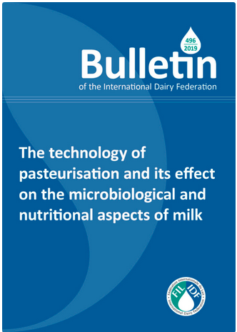
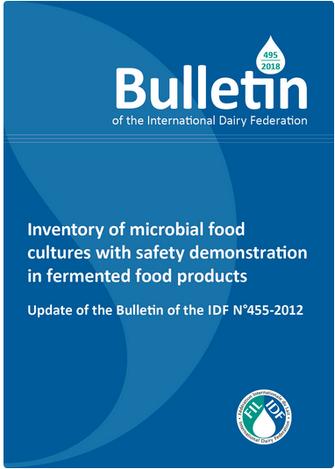
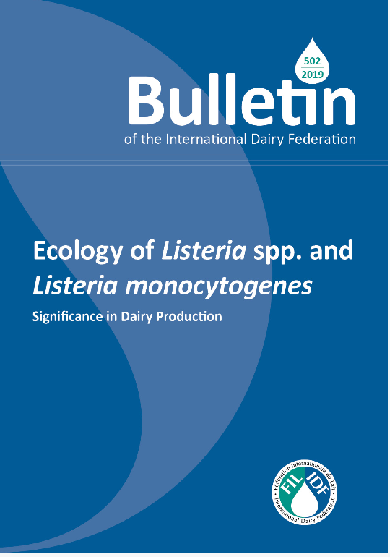
Guidance on Microbiological Hygiene

Slide 22
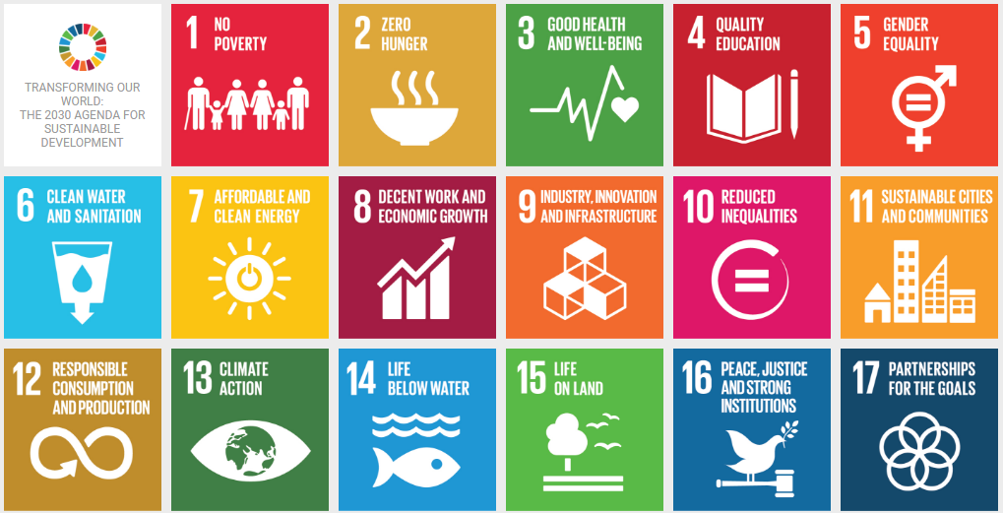
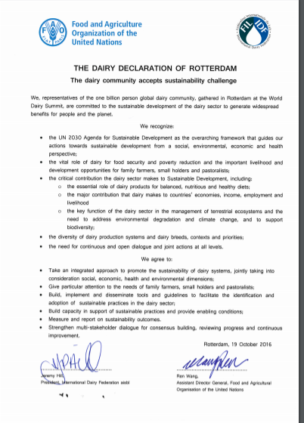
Dairy’s Commitment to sustainability
The dairy sector and the FAO signed on to the Dairy Declaration of Rotterdam in 2016:
  “We, representative of the one-billion-person global dairy community, gathered in Rotterdam at the World Dairy Summit, are committed to the sustainable development of the dairy sector to generate widespread benefits for people and the planet.”
Notes:
In 2016, IDF and the FAO signed the Dairy Declaration of Rotterdam committing to sustainability and contribution to the SDGs.

Slide 23
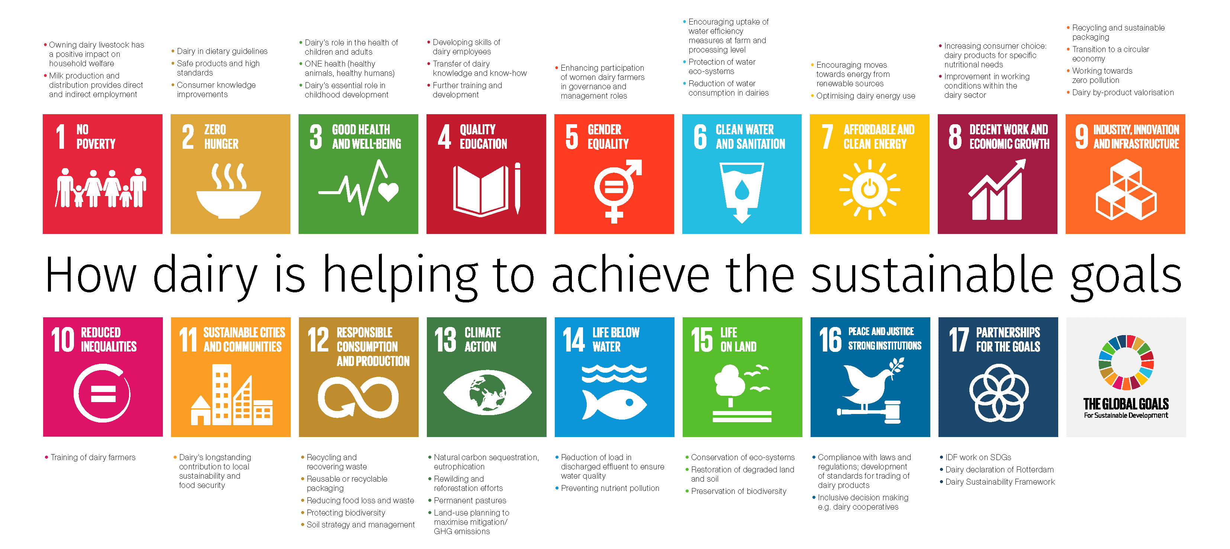
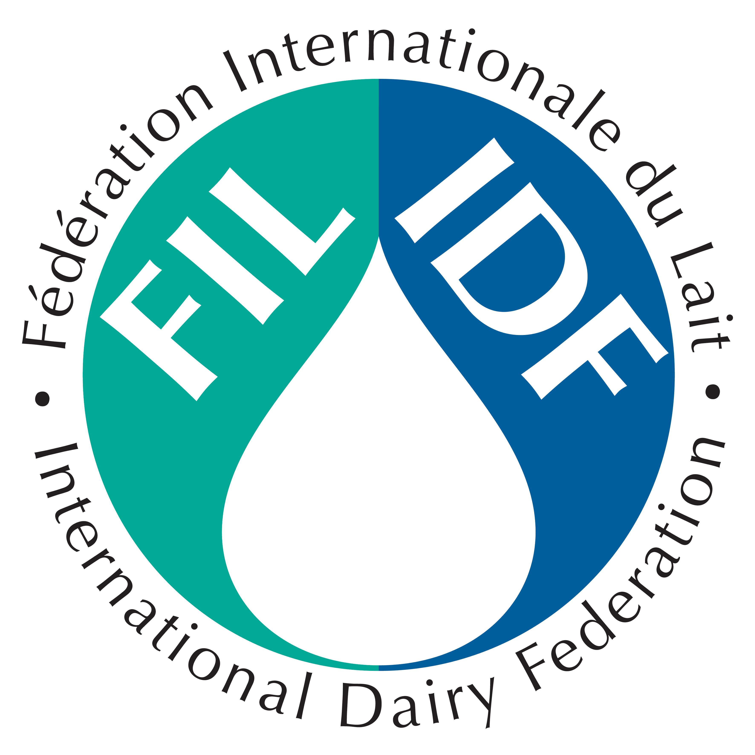
Dairy and sdgs
Notes:
The dairy sector is an essential contributor to the UN sustainable development goals. While the sector has obvious impacts on ending hunger, achieving food security, and improving the nutritional value of diets in a sustainable manner, the sector also has an important part to play in the achievement of many of the other sustainability goals identified.
This page in our Annual Report includes links to selected concrete examples from the dairy sector. For many more examples of sustainable dairying by IDF members, read IDF’s latest Dairy Sustainability Outlook, released in June 2021.

Slide 24

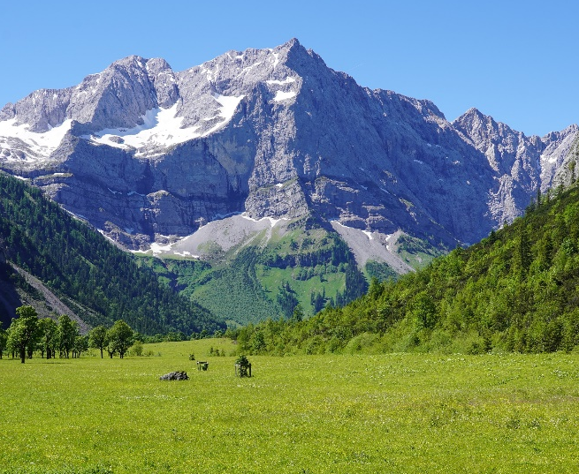
The Better Environment: a narrative
The Better Environment is the foundation for the other betters
Better Life
Resilience of livelihoods &
green jobs
Better Production
Better Nutrition
BETTER ENVIRONMENT
Greening agrifood systems (agriculture & supply chains) and restoration for production
Healthy and diversified diets
& food safety
Natural capital protection, sust. managt & restoration
+ climate change adapt and mitigation

Slide 25
IDF work on Sustainability
Significant work on human nutrition, School Milk Programs, animal and health and welfare, livelihood and socio-economic.
Work programme on environment: GHG methodology, Net Zero: Pathways to Dairy Net Zero Initiative, positive contribution of dairy on bioenergy and biodiversity, contribution to LEAP and GASL.
Communications on science-based:
  IDF Dairy Sustainability Outlook, three editions so far
  Several webinars yearly on the subject

Slide 26
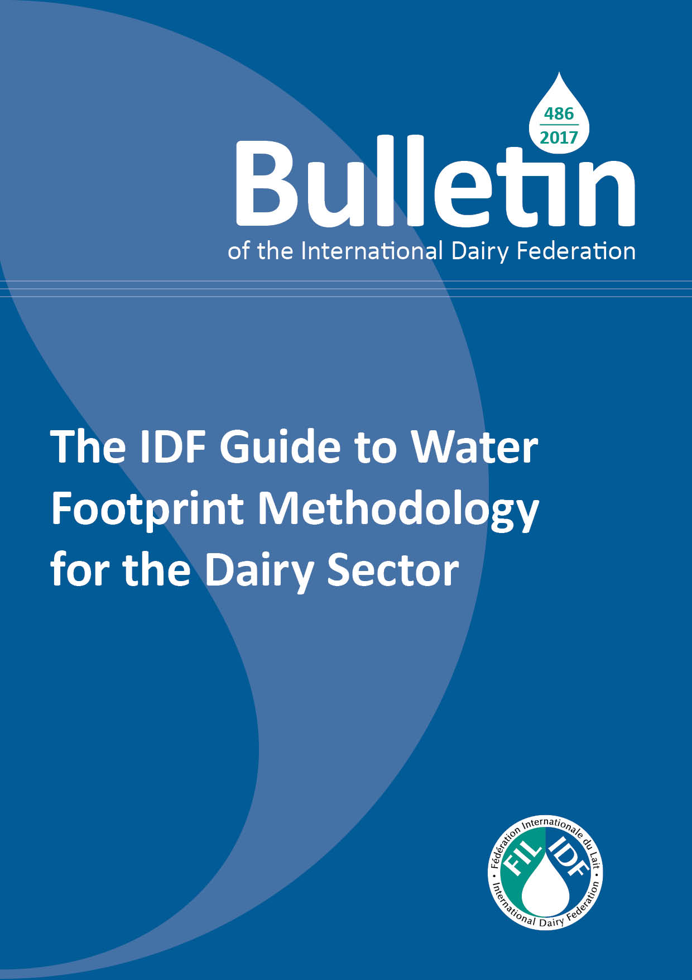
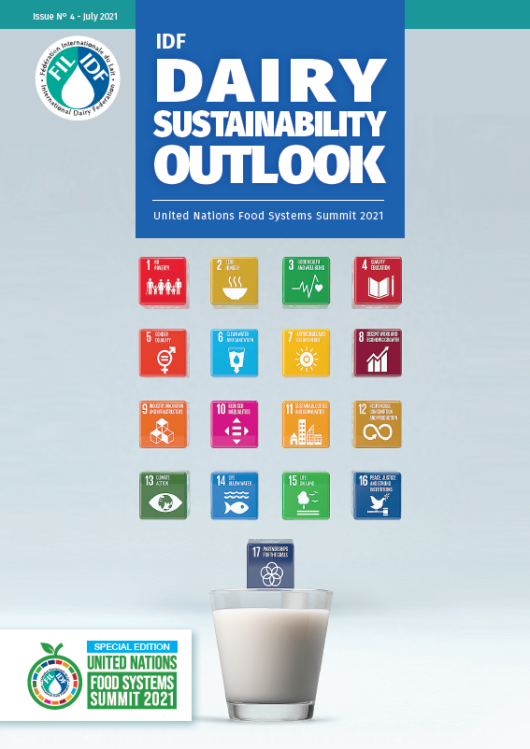
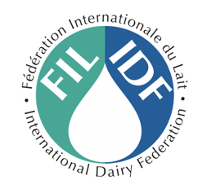
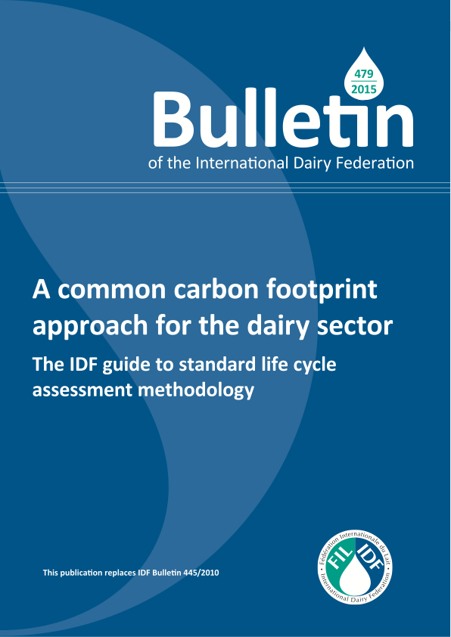

Slide 27
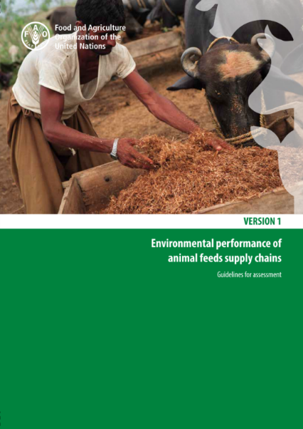
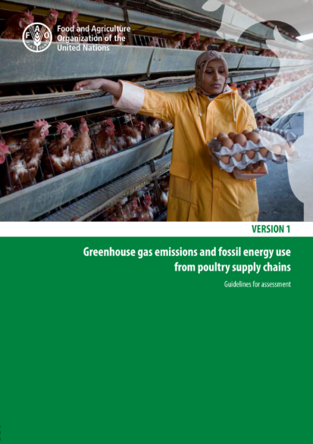
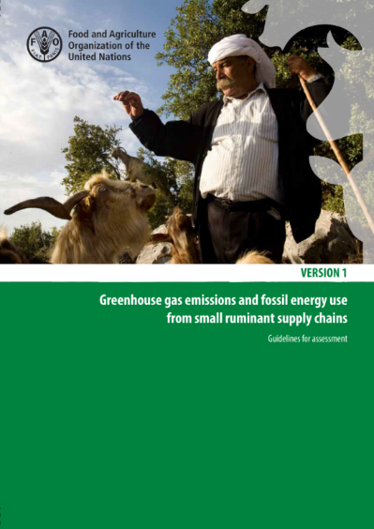
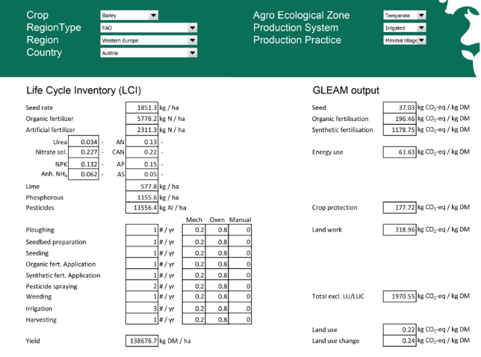
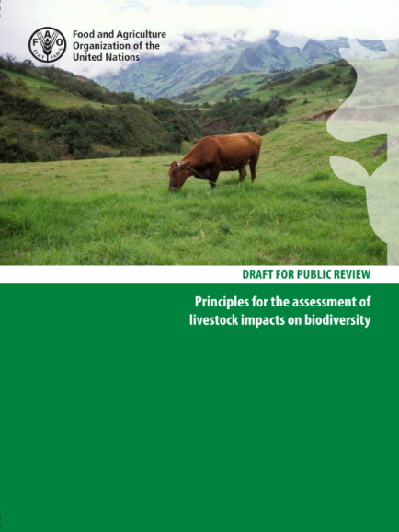
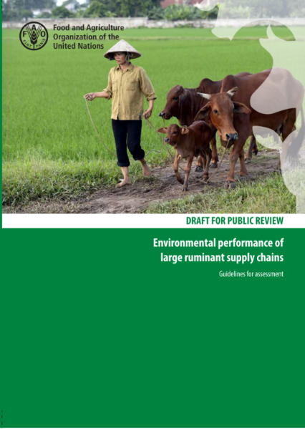
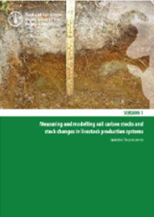
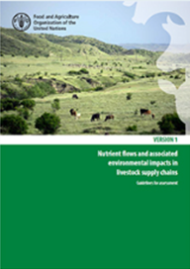
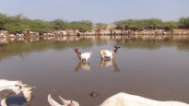
LEAP Achievements
Feed
Poultry
Small Ruminants
Feed Crops Database
Pigs
Biodiversity
Large ruminants
Methodological notes
Soil carbon
Nutrients cycle
Water
Feed Additives
Biodiversity
Notes:
IDF is member of the Global Action for Sustainable Livestock-GASL/FAO and
Livestock Environmental Assessment and Perfomance Partnership- LEAP-FAO contribution in providing methodologies to measure environmental perfomance is critical. IDF is a founder and has been an active participant to that work. New workstream on carbon sequestration and methane.

Slide 28
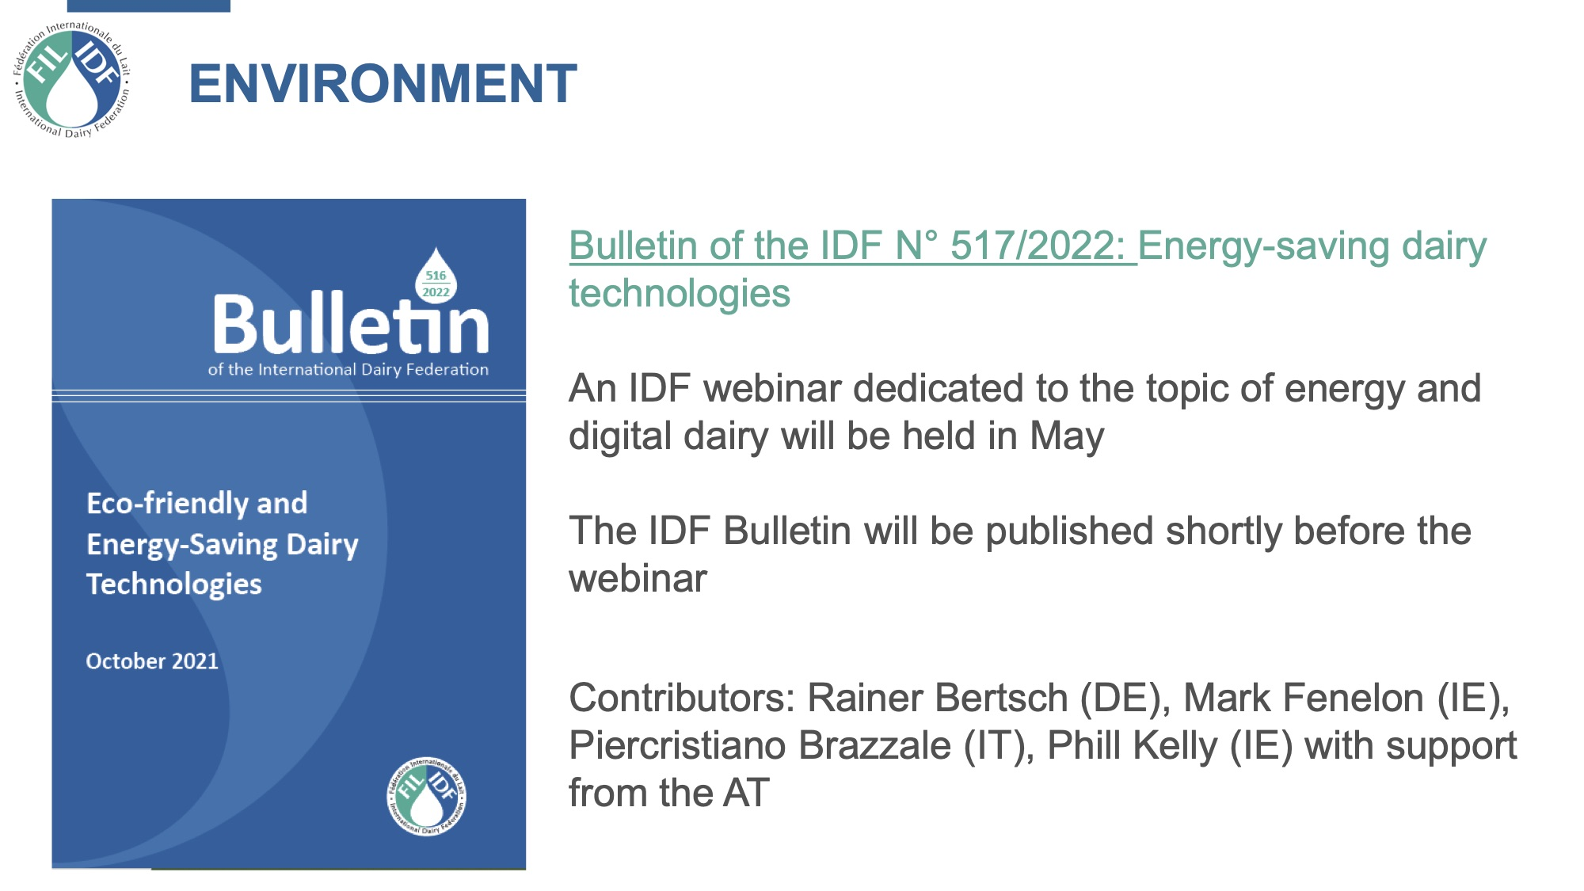

Slide 30
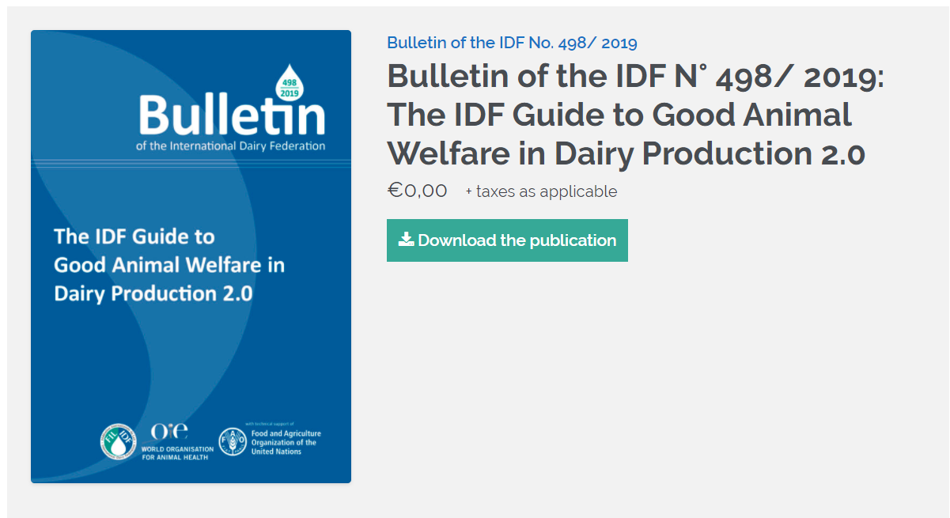

Slide 31
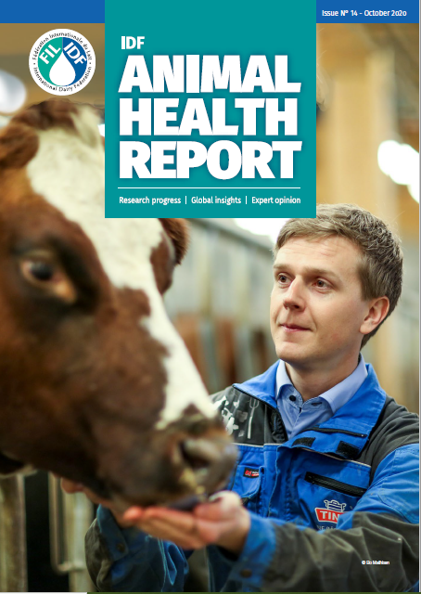
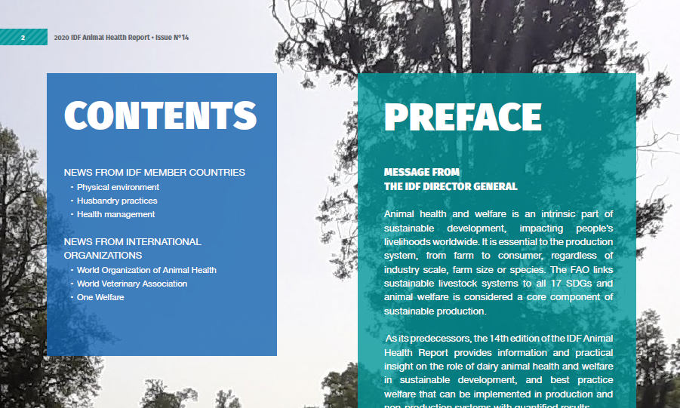
ANIMAL HEALTH AND WELFARE
IDF Animal Health Report n14
17 Articles
Expertise from 11 different countries and 3 international organisations
Notes:
The issue is completed with information on the OIE annual data collection on antimicrobial agents intended for use in animals, a global livestock initiative which includes responses from 153 countries. It offers an opportunity for those involved in the field to share findings of innovative research and provide an update on progress achieved and lessons learned.

Slide 32
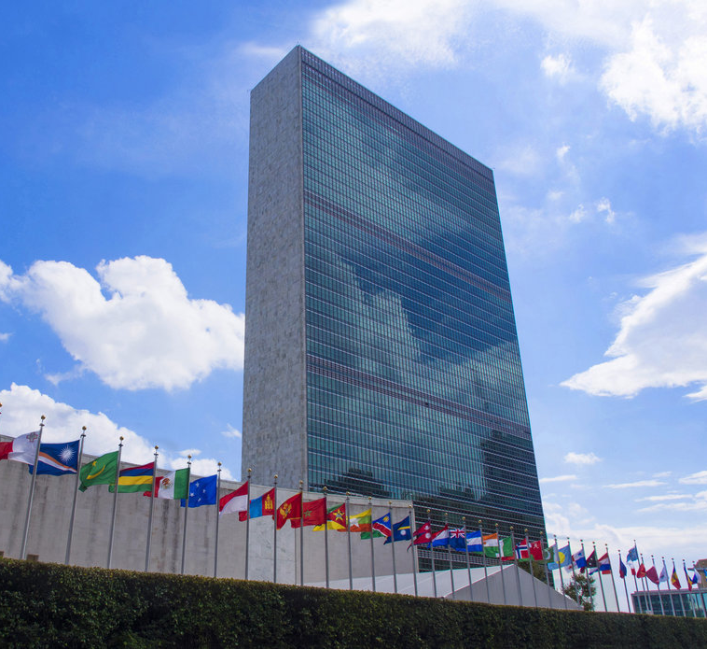
Food systems dialogue
In 2021, UN Secretary-General António Guterres has gathered a Food Systems Summit to raise global awareness and land global commitments and actions that transform food systems to resolve not only hunger, but to reduce diet-related disease and heal the planet. The Secretary General called for collective action of all citizens to radically change the way we produce, process, and consume food.

Slide 33
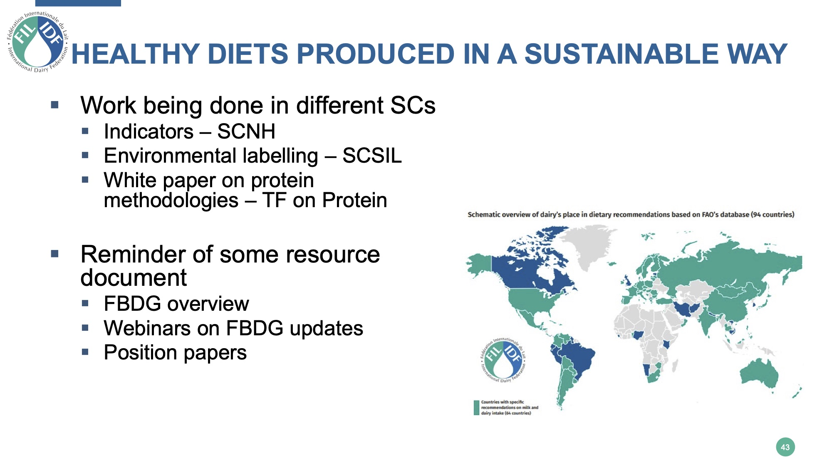
Notes:
FBDG:Food based dietary guidelines

Slide 34
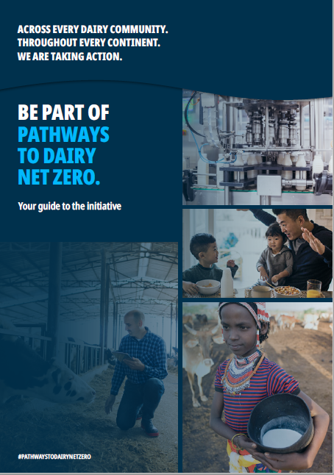
THE INITIATIVE
AND ITS PRINCIPLES
Dairy helps create sustainable food systems, ensuring high quality nutrition for all. But dairy, like all sectors, knows there is more work to do. Across every dairy community. Throughout every continent. We are taking action.
Pathways to Dairy Net Zero raises dairy’s ambition to accelerate climate action by reducing greenhouse gas emissions over the next 30 years.
There are two ways for organizations to endorse the initiative:
By taking direct action on GHG mitigation, and/or
By supporting and promoting its principles
Notes:
Dairy contributes to UN Sustainable Development Goals and to sustainable food systems, ensuring high quality nutrition for all. The global dairy sector committed to sustainability with the Dairy Declaration of Rotterdam signed by IDF and the FAO in 2016. Dairy knows there is more work to do. That is why this initiative is stimulating a movement: Across every dairy community. Throughout every continent. We are taking action.
Pathways to Dairy Net Zero raises dairy’s ambition to accelerate climate action by reducing greenhouse gas emissions over the next 30 years. It is driven by the global dairy sector and supported by knowledge partners, leading scientific and research organizations.
You can join too. There are two ways for your organization to endorse the initiative:
By taking direct action on GHG mitigation, and/or
By supporting and promoting its principles

Slide 35
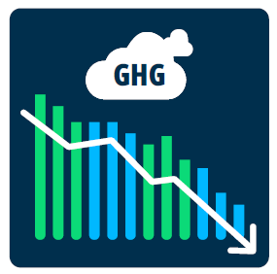



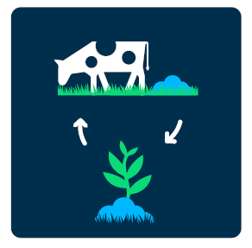






OUR PRINCIPLES
Continuing to improve production
and process efficiency to further
reduce the emissions intensity of
milk and dairy products.
Balancing emissions with additional
and credible offsets.
Enhancing production practices
that protect carbon sinks (soil,
forests, grass and peatlands) and
complement natural ecosystems.
Measuring greenhouse gas
emissions and reporting progress..
Improving practices such as feed, manure, fertilizer and energy management.
Promoting the initiative and
emphasizing the dairy sector’s
climateambition.
OVERALL SUPPORT
Notes:
Our principles are focused on:
REDUCTION & MITIGATION: Continuing to improve production and process efficiency to further reduce the emissions intensity of milk and dairy products
INSETS & OFFSETS: Balancing emissions with additional and credible offsets.
GREEN HOUSE GAS REMOVALS: Enhancing production practices that protect carbon sinks (soil, forests, grass and peatlands) and complement natural ecosystems.
MEASUREMENT & MONITORING: Measuring greenhouse gas emissions and reporting progress..
AVOIDANCE AND ADAPTATION: Improving practices such as feed, manure, fertilizer and energy management.
OVERALL SUPPORT: Promoting the initiative and emphasizing the dairy sector’s climate ambition.

Slide 36
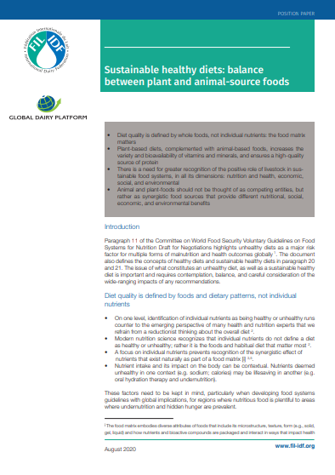
Joint statement GDP-IDF on plant based
Diet quality is defined by whole foods, not individual nutrients: the food matrix matters
Plant-based diets, complemented with animal-based foods, increases the variety and bioavailability of vitamins and minerals, and ensures a high-quality source of protein
There is a need for greater recognition of the positive role of livestock in sustainable food systems, in all its dimensions: nutrition and health, economic, social, and environmental
Animal and plant-foods should not be thought of as competing entities, but rather as synergistic food sources that provide different nutritional, social, economic, and environmental benefits

Slide 37

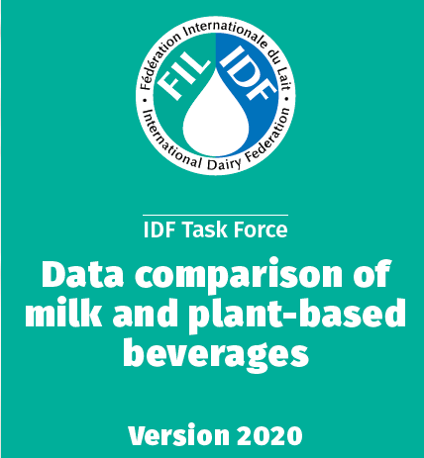
Notes:
Diet quality is defined by whole foods, not individual nutrients: the food matrix matters
Plant-based diets, complemented with animal-based foods, increases the variety and bioavailability of vitamins and minerals, and ensures a high-quality source of protein
There is a need for greater recognition of the positive role of livestock in sustainable food systems, in all its dimensions: nutrition and health, economic, social, and environmental
Animal and plant-foods should not be thought of as competing entities, but rather as synergistic food sources that provide different nutritional, social, economic, and environmental benefits

Slide 38
Global Opportunities
Promote the role of dairy in healthy diets produced in a sustainable manner and the contribution of dairy to the UN SDGs. E.g. UN Food Systems Summit.
Continue to support research and innovation and promote the science behind dairy.
Provide knowledge and expertise to IGO such as Codex and OIE and regulators.
Support the global dairy sector to overcome these times of uncertainty
Notes:
Promote the role of dairy in healthy diets produced in a sustainable manner and the contribution of dairy to the UN SDGs. E.g. UN Food Systems Summit.
Continue to support research and innovation and promote the science behind dairy.
Provide knowledge and expertise to IGO such as Codex and OIE and regulators.

Slide 39
Conclusions
The global dairy sector is:
expanding (or prospering), due to population and per capita consumption growth
key to global nutrition and food security
significant contributors to achieve the UN SDGs
dynamic and resilient
Dairy will remain part of healthy and sustainable diets.
Notes:
Despite everything……

Slide 40
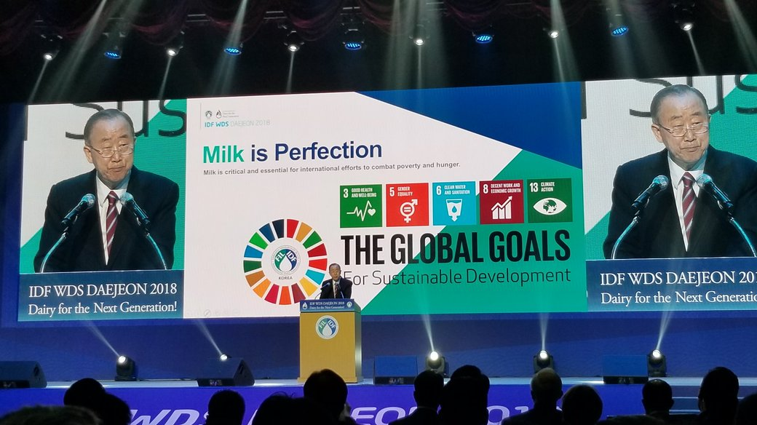
Notes:
The former UN Secretary-General of the United Nations Ban Ki Moon said it well at the IDF World Dairy Summit in Korea in 2018: Milk is perfection! He acknowledged that dairy contributes to several UN Sustainable Development Goals. “The dairy sector plays a leading role in international efforts to achieve the Sustainable Development Goals which are aimed at socio-economic transformation to eradicate poverty and hunger, and to construct a sustainable world where humanity can enjoy better education, healthcare, and equality.”
The Global Story of the Dairy Sector is strong!

Slide 41
IDF-WDS 2022
New Delhi, INDIA
Theme : Dairy for Nutrition & Livelihood
Dates: 8 – 16 September 2022
  BUSINESS MEETINGS : 9-11 SEPTEMBER 2022
  WDS CONFERENCE : 12-15 SEPTEMBER, 2022
  SOCIAL & TECHNICAL TOURS : 15-16 SEPTEMBER, 2022
Venue: India Expo Center, Greater Noida
National Capital Region (NCR), New Delhi
Tours
  Social: New Delhi, Agra & Jaipur
  Technical
    Visit to a typical Indian dairy farm
    State-of-the-art dairy plant
    Visit to Anand, Gujarat- The Milk Capital of India

Slide 42
