Slide 1
Global Key Drivers For the dairy sector
INTERNATIONAL DAIRY FEDERATION
Dairy olympics Russia
Brazzale Piercristiano
24 May 2021

Slide 2
2020 so far and beyond
Dairy sector was disrupted but showed resilience facing COVID-19
Dairy sector has adapted : there has been no major interruption in availability and it answered to the changes in consumption patterns, more or less recapturing the losses of sales in food service channel through the retail channel
Overall, international demand maintained, prices have stabilized and dairy trade was quite stable
Impacts on 2021 are highly uncertain at this point.
  Food is part of the essential needs. Dairy is part of the diet and well positioned as it meets the demand for more home cooking and healthy food.
  Dairy Sector has demonstrated its capacity to adapt to the changes of consumption patterns
Notes:
Dairy sector was disrupted but showed resilience facing COVID-19
Dairy sector has adapted : there has been no major interruption in availability and it answered to the changes in consumption patterns, more or less recapturing the losses of sales in food service channel through the retail channel
Overall, international demand maintained, prices have stabilized and dairy trade was quite stable
Impacts are 2021 are highly uncertain at this point.
Food is part of the essential needs. Dairy is part of the diet and well positioned as it meets the demand for more home cooking and healthy food.
Dairy Sector has demonstrated its capacity to adapt to the changes of consumption patterns
Impacts are 2021 are highly uncertain at this point. The level of available income will have impact for sure.

Slide 3
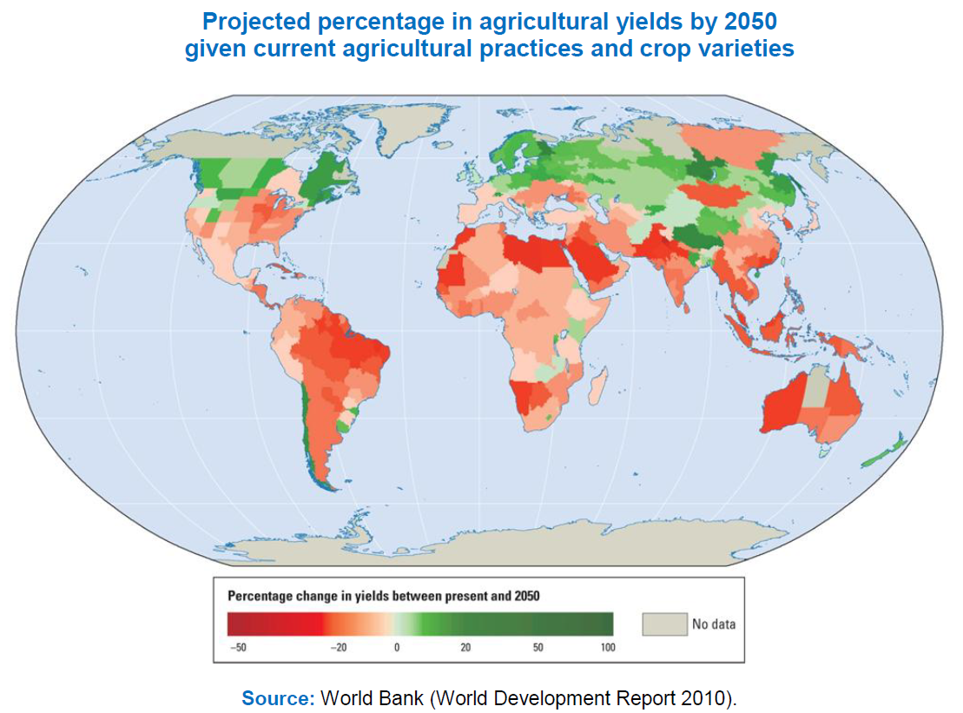


Global key drivers:
Population growth, climate change
By 2050 >9 billion
Projected percentage in agricultural yields by 2050 given current agricultural practices and crop varieties
Percentage change in yield between present and 2050
Source: World Bank (Development Report 2010)
Notes:
Population growth is an important driver for our sector. We need to nourish (I am not using feeding on purpose quality of food matters) more people while reducing our impact on the environment and increasing the positive contribution to livelihood, women empowerment and eco-services.
Improving milk production is key to address climate change. When I talk in Africa or India for example, I always insist of how to improve production efficiency per animal since it can have a direct impact on climate change but also to improve the livelihood of the farmers and the health of the dairy animals.

Slide 4
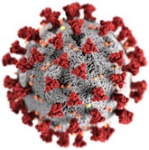
Global key drivers of Dairy industry from the consumer perspective
Industry
Ingredient list shortening
Consumer
Branding
Health & nutrition
Rights and welfare of workers
New experience
Lowering valuation
Animal health Animal welfare
Convenience and snack
Food safety
Comunication
Traceability
Clean supply chain
Sustainability
Clean and clear lable
New ingredients
Corporate structure changes: agility
Notes:
Reduced scale: not a prerequisite to reach consemers ; they’re fed up with big brands & prefer local ones
Food safety:the products must be safe ,healthy and nutricious
Animal health and animal welfare
Sustainability & ethics:
The dairy sector must takes its commitment to protecting our world’s resources seriously.
Higher expectations drive consumers to be well-informed.
Wellbeing:
Consumers are treating their bodies like an ecosystem and seeking solutions that complement their personal health and evolving needs.Bioactive and healthy dairy products.
Plant-based:
Plant based eating and drinking is moving from trend to food revolution status, across all dairy categories (Milk, Cheese, Butter, Yoghurt)
Hi-tech harvests:
Consumers will take a more vested interest in agriculture, fuelled by priorities for plants in our diets. Ethical stance on animal farming and ‘naturalness’ will come to fore.
Story Telling:
Increased consumer interest in the origin on their food and beverage products is resulting in ingredient provenance proving its worth as a key element of brand storytelling
Clean (Pure eating):
Higher protein concentrations (yoghurt), low fat, low lactose ingredients. Clean label and transparent. NUTRITION IS KING
Gut Health/Immunity:
Accelerated by COVID-19, this trend on understanding the gut/brain dyad is growing exponentially. Dairy is the primary carrier and can own this space with ferments and ingenuity. Native immunity claims and products can be stretched and used for endorsement.

Slide 5
Where do the Major Trends Actually Sit?
Health
Convenience
Sustainability
RELAUNCH
& innovation
Traceability
Degree of progression
New experience
& storytelling
New ingredients
Mental health
& immunity
Start-up
Growth
Maturity
Decline

Slide 6





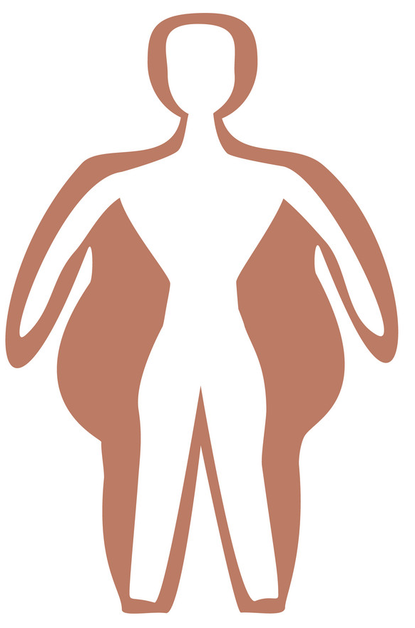


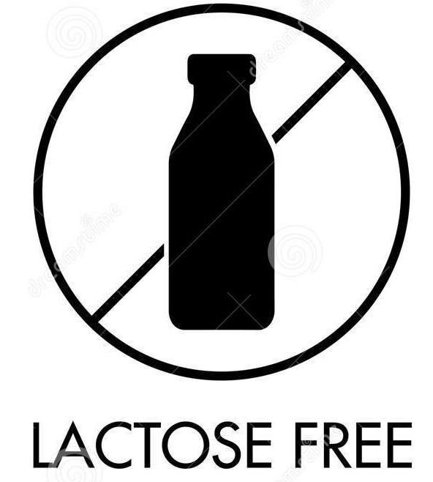

6 Major Drivers of Change in the food Sector
Health through food is accentuate by the current crisis
Six Global Game Changers
Source: Healthy marketing team
PEOPLE
Are getting more, Older & Wealthier
PRODUCTION
With Natural &Transparent Processes
FOOD
For Health
& Wellbeing
RESOURCE
Are
getting Scarce
TECHNOLOGY
Empower
Consumers
SCIENCE
For a Smarter Future
Dairy Health benefits
Bones health
Obesity
Lactose intolerance
Digestive health
High protein
Calcium
Low fat
Low sugar
Lactose free
Prebiotic
Probiotic
Fibers
Weight management
Muscle maintenance
Better nutrition
Lactoferrin &
vitamins

Slide 7







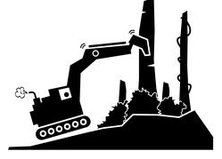



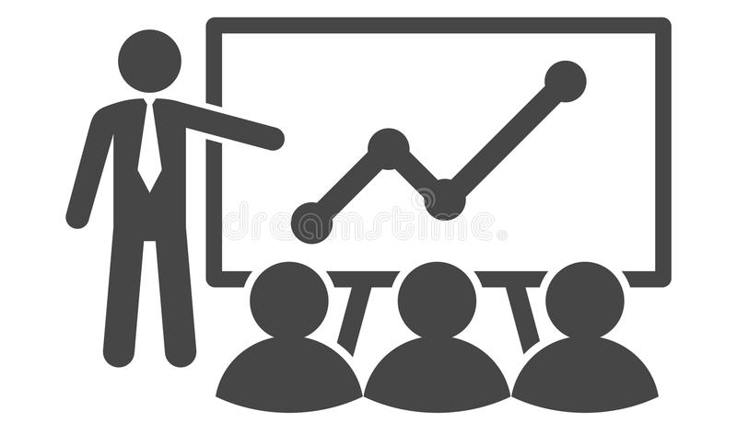


Main Concrete Actions of Major Companies
Main actions start at the farm level
Main actions of dairy companies for sustainable development
Consumer concern and awareness
Environnement
Social
Economy
+
Carbon footprint
Water use
Waste
Energy
Responsible sourcing
Hunger and poverty
Animal welfare
Nutrition
Deforestation
Education
Gender equality
Employment and training
Farmer incomes
Partnerships
-

Slide 8




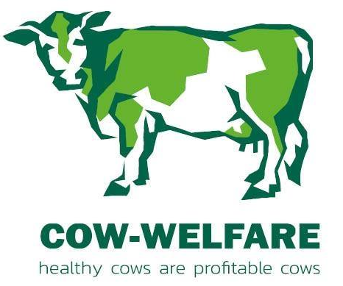

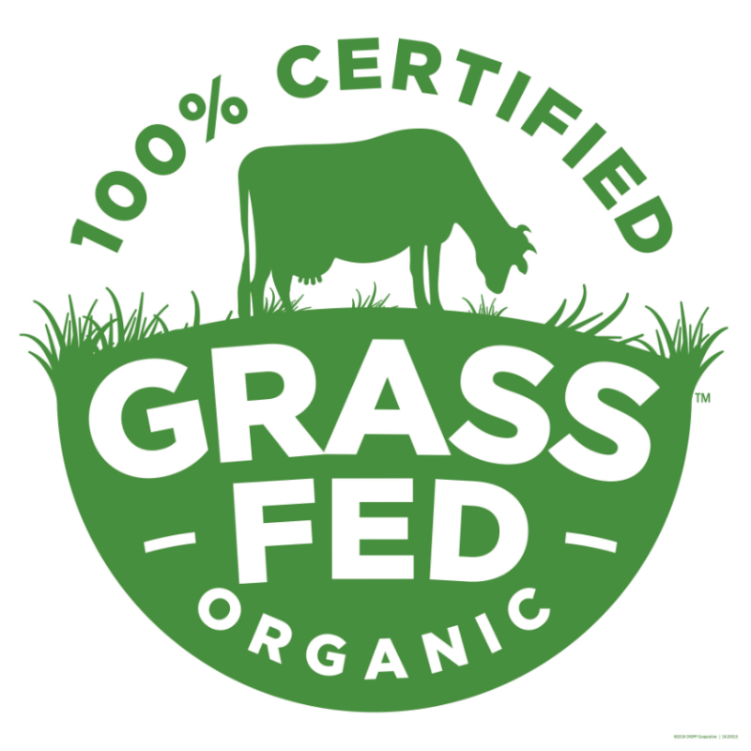
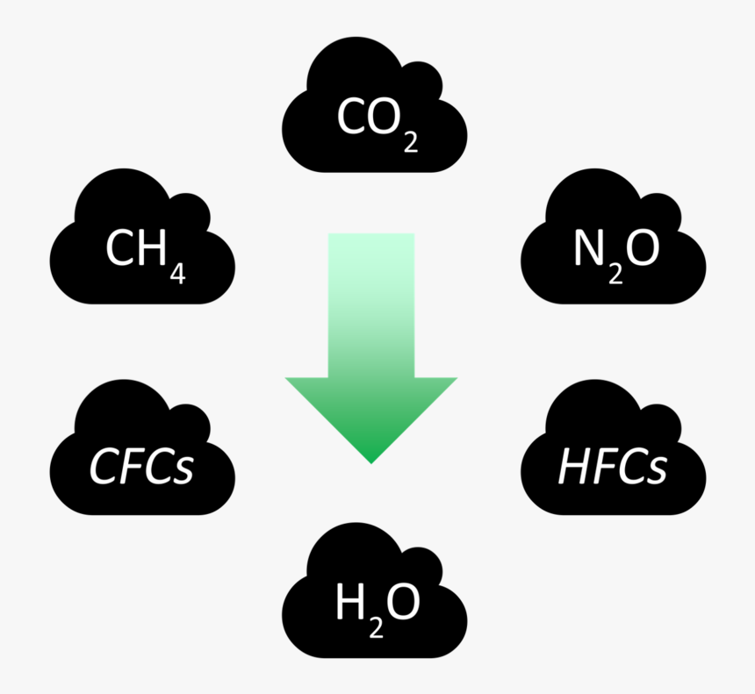
Increasing Preoccupations Around Sustainability
Will have impacts on the dairy sector
Increasing number of initiatives
2) Around a wide pallet of commitments
Best practise guides
Carbon footprint
Water use
Waste
Energy
…
Net Zero Pathways to Low Carbon Dairy
GASL
LEAP
Animal welfare
Nutrition
Responsible sourcing
Farmer incomes
3) Movement toward quality and sustainability
Quality and added-value instead of quantity
Pasture based
Environmental pressures
High animal welfare standards
Organic
Notes:
The most Important drivers are dairy safety & quality and sustainable farming.
Consumers and governments expect safe and quality products that:
Meet international standards
Are prevented from adulteration (in milk) and food fraud
They also expect sustainable dairy farming and processing. This is why we participate to multi-stakeholders platform such as the FAO-Global Agenda for Sustainable Livestock and Livestock Environmental Performance Assessment Partnership (LEAP).

Slide 9
IDF SUPPORTING THE
Global Dairy SECTOR
INTERNATIONAL DAIRY FEDERATION

Slide 10

What is the IDF?
Established in 1903
Members in 43 countries representing 75% of world milk production
1,200 experts working in 17 Standing Committees and 3 Task Forces
Accredited to the FAO, Codex, OIE, UNEP, ECOSOC
Notes:
IDF is one of the oldest international organizations which was created in 1903 to set standards on milk and milk products.
We have 43 member countries, including Canada.
We are a network of dairy experts.

Slide 11
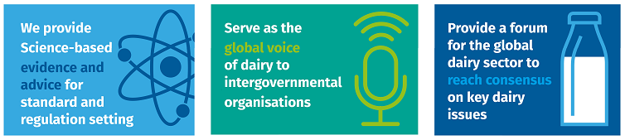
IDF in brief
Our mission: To help nourish the world with safe and sustainable dairy.
Notes:
Our mission is to help the world with safe and sustainable dairy.
Our roles to:

Slide 12
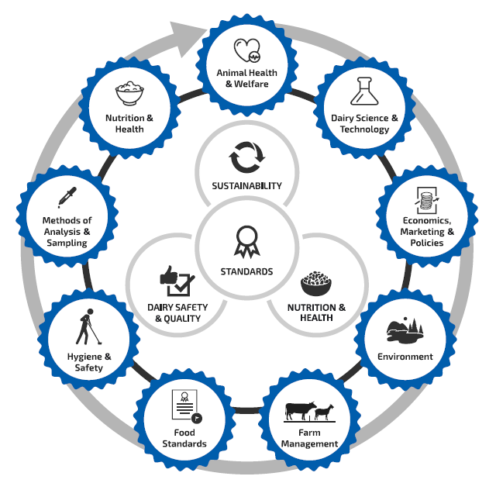
Idf working areas
1,200 experts covering nine areas of work

Slide 13


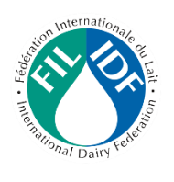



IDF achievements on Standards
1903
1947
1963
1995
2020
Technical Barriers to Trade (TBT) & Sanitary and Phytosanitary Measures (SPS) agreements
Notes:
IDF has long-standing formal relationships with the FAO, Codex, OIE, ISO, OECD and WHO
We contribute to:
Standard setting
IGO consultations affecting dairy
The publication of science-based research, including joint standards with ISO
Major relevant events and conferences
1903: foundation of IDF
1947: Creation of ISO
1963: creation of Codex Alimentarius and publication of first Codex standards for milk products.

Slide 14






IDF contributions to International Standards
IDF is working with International organization on standards relevant for dairy products, for examples:
  Codex - Nitrogen Conversion Factor Standards for Dairy & Soy
  Codex: Guidelines for reuse of water
  Front of Pack Nutrition Labelling
  OIE
  ICAR

Slide 15
UNIQUE IDF/ISO collaboration on Methods of Analysis for MILK AND MILK PRODUCTS
188 IDF/ISO standards published to date, including 60 recommended by the Codex Alimentarius
IDF is currently working on the following methods including:
  Determination of alkaline phosphatase activity — Fluorimetric microplate method (marker for pasteurisation)
  Guidelines for the validation of qualitative screening methods for the detection of residues of veterinary drugs in milk and milk products
  Nutrients in Infant Formula, in collaboration with AOAC International
  Microbiological methods, revision of standard for Enumeration of characteristic microorganisms in yoghurt

Slide 16
IDF protects HEALTH through FOOD SAFETY Guidance and standards
Guide to Prudent use of antimicrobial agents in dairy production
Review on Listeria in dairy production
Inventory of historically safe use of micro-organisms
Technology of Pasteurisation and its effects on the microbiological and nutritional aspects of milk
Joint IDF/ISO standards for analytical methods: i) Milkfat purity and ii) Whey protein in milk-based infant formula
Notes:
IDF has also published guidance on :
the use of antimicrobial agents for the dairy sector (farmers, veterinaries, authorities)
On the occurrence and control measure of listeria in the dairy sector
An inventory of microorganisms used in food with a history of safe use (in dairy products but not only)
On the technology of pasteurisation, its effect on microbiological and nutritional aspects of milk
IDF publishes together with ISO, the International Organisation for Standardisation, joint standards for methods of analysis for milk and milk products. 180 standards to date. One recent publication is a standard on milkfat purity. Another example is a reference method for the determination of freezing point (use to determine water adulteration).

Slide 17
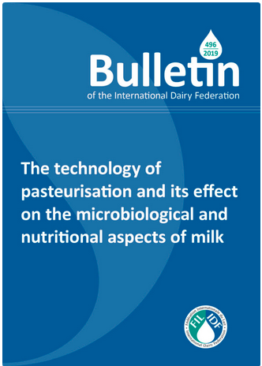
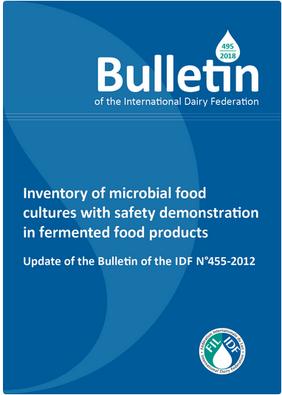
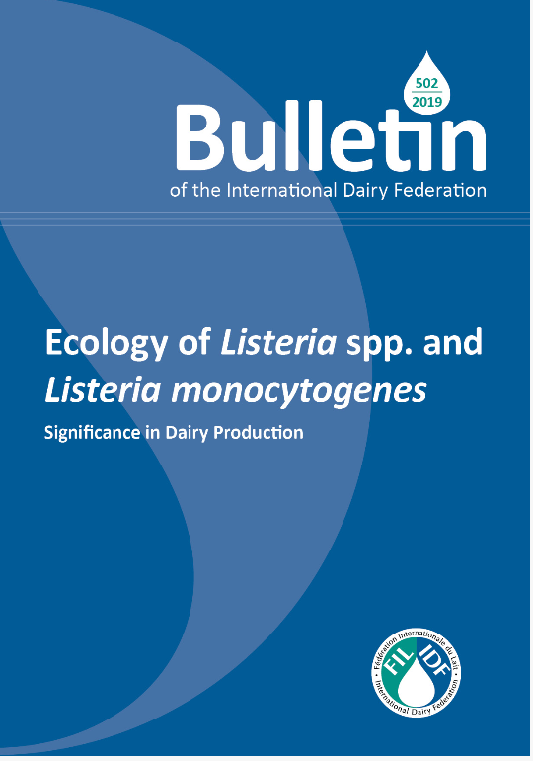
Guidance on Microbiological Hygiene

Slide 18
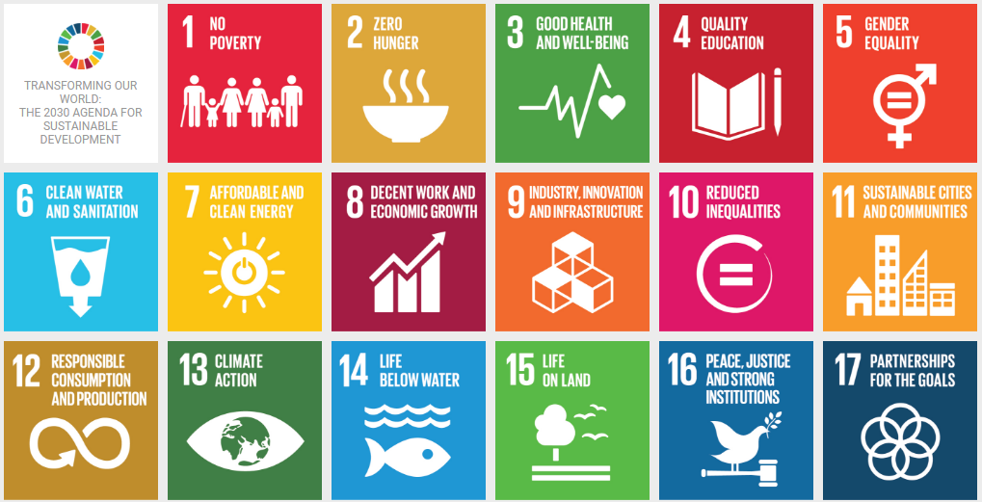
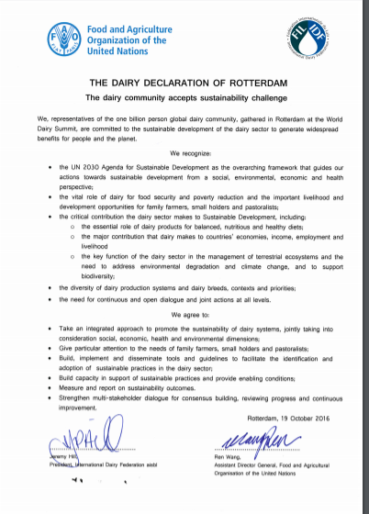
Dairy’s Commitment to sustainability
The dairy sector and the FAO signed on to the Dairy Declaration of Rotterdam in 2016:
  “We, representative of the one-billion-person global dairy community, gathered in Rotterdam at the World Dairy Summit, are committed to the sustainable development of the dairy sector to generate widespread benefits for people and the planet.”
Notes:
In 2016, IDF and the FAO signed the Dairy Declaration of Rotterdam committing to sustainability and contribution to the SDGs.

Slide 19
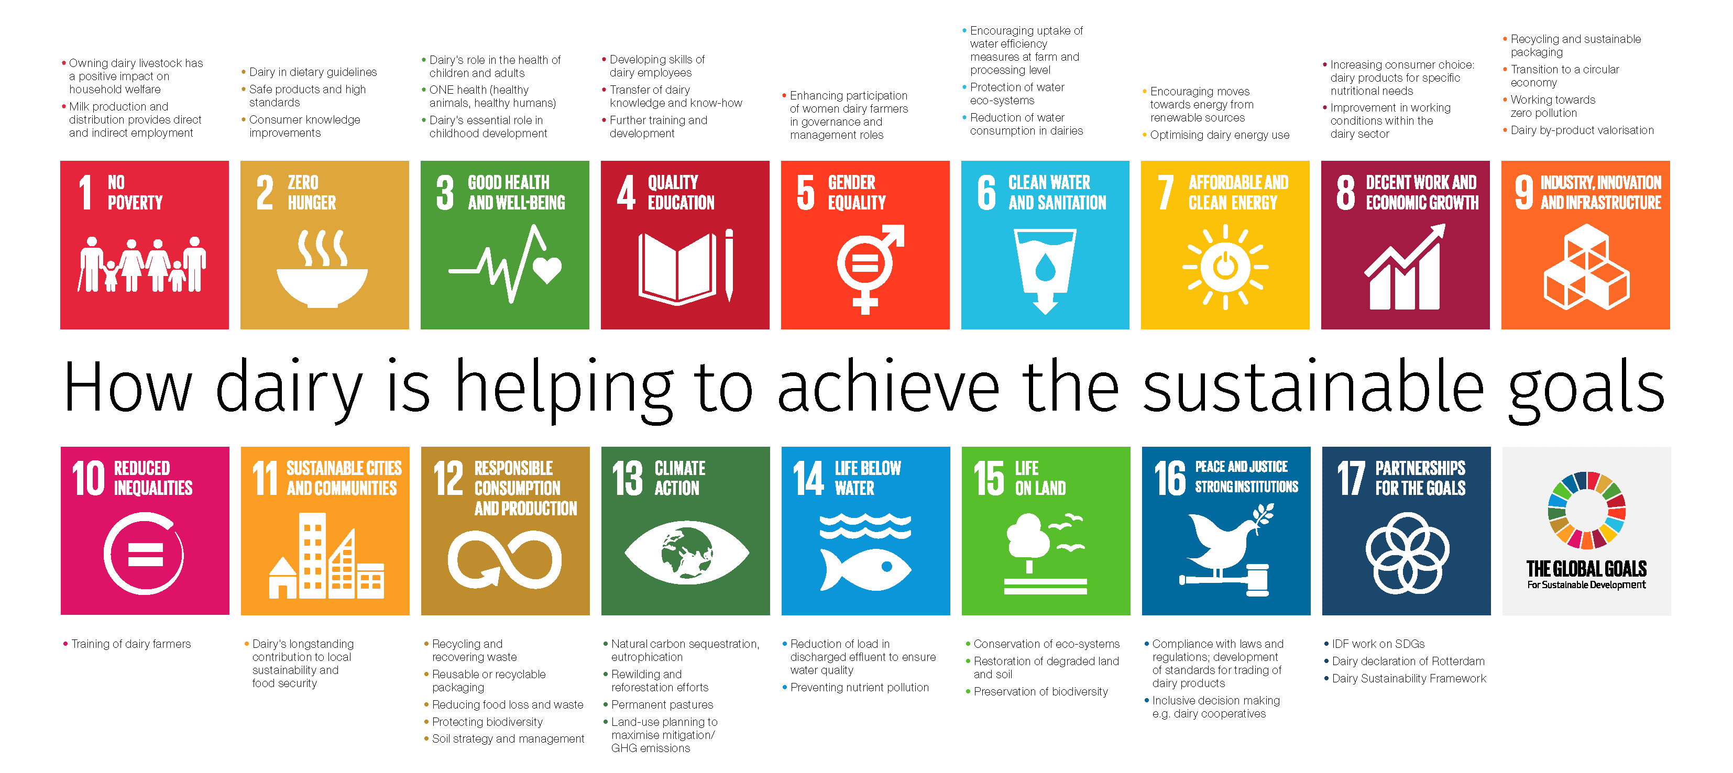
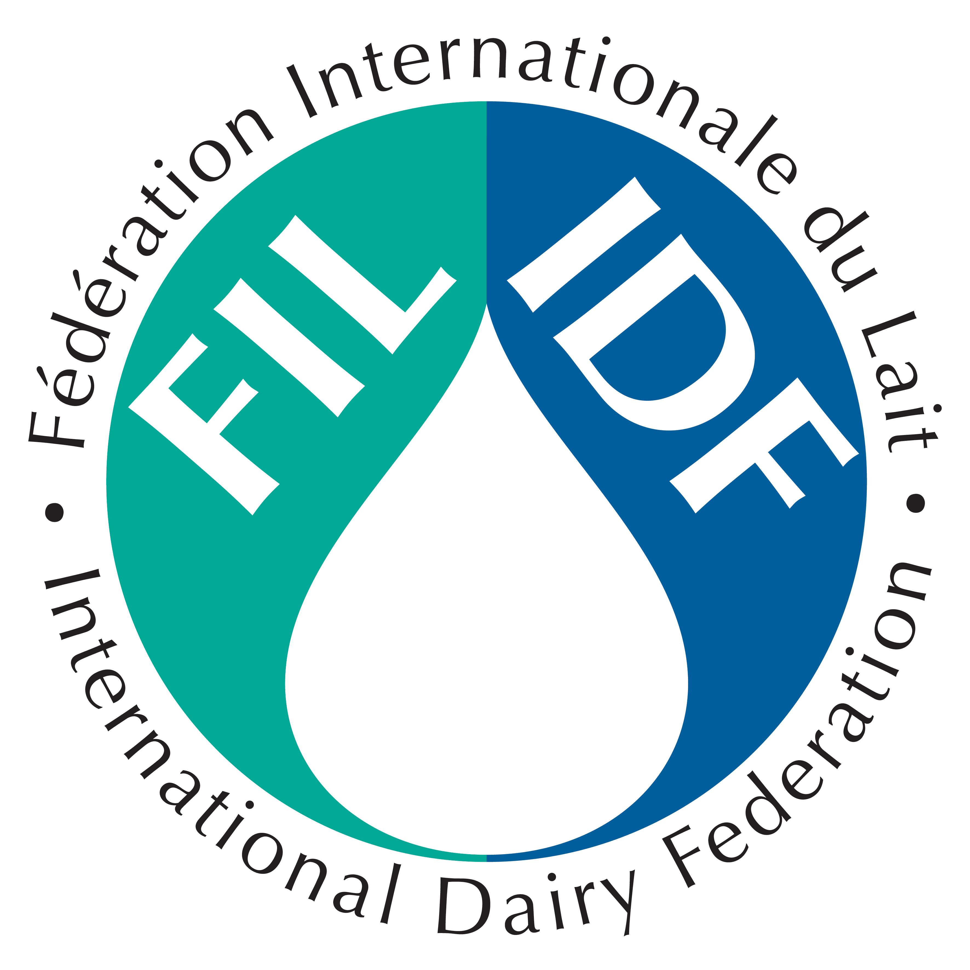
Dairy and sdgs
Notes:
The dairy sector is an essential contributor to the UN sustainable development goals. While the sector has obvious impacts on ending hunger, achieving food security, and improving the nutritional value of diets in a sustainable manner, the sector also has an important part to play in the achievement of many of the other sustainability goals identified.
This page in our Annual Report includes links to selected concrete examples from the dairy sector. For many more examples of sustainable dairying by IDF members, read IDF’s latest Dairy Sustainability Outlook, released in June 2020.

Slide 20
IDF work on Sustainability
Significant work on human nutrition, School Milk Programs, animal and health and welfare, livelihood and socio-economic.
Work programme on environment: GHG methodology, Net Zero: Pathways to Low Carbon Dairy Initiative, positive contribution of dairy on bioenergy and biodiversity, contribution to LEAP and GASL.
Communications on science-based:
  IDF Dairy Sustainability Outlook, three editions so far
  BAMST/IDF Symposium 2019: The Role of Ruminants in sustainable diets: https://www.fil-idf.org/bamstidfevent2019/

Slide 21
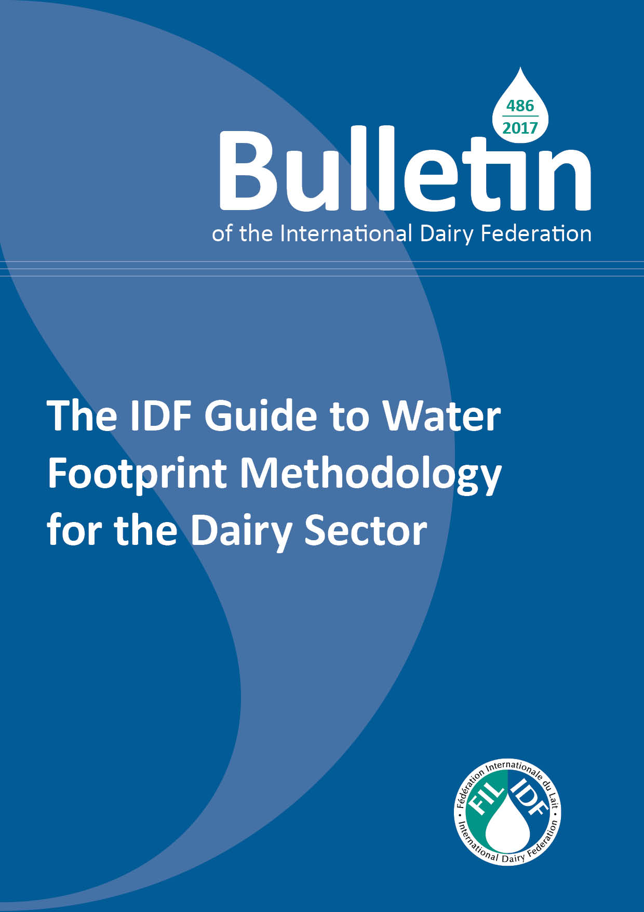
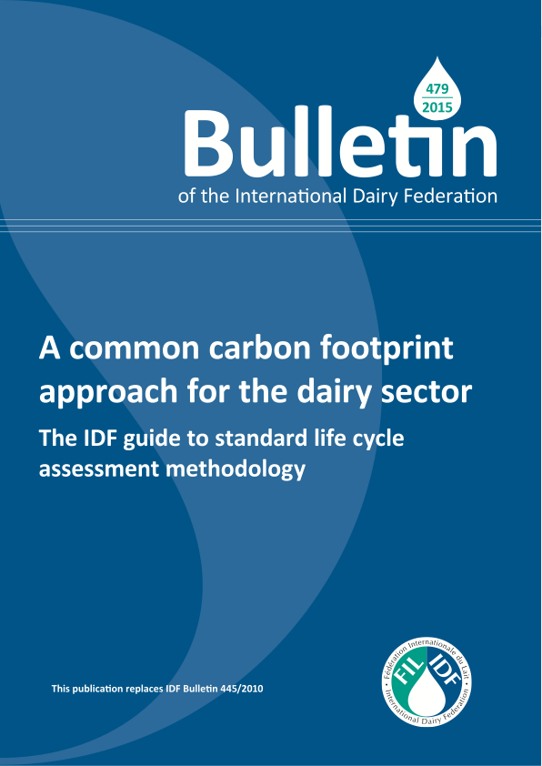

Slide 22
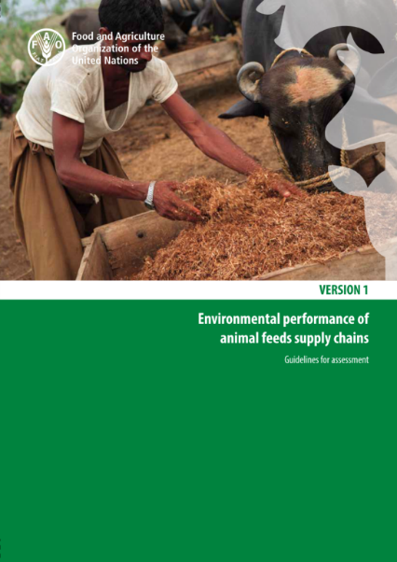
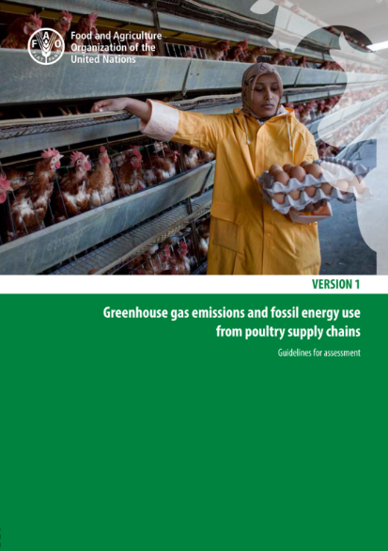
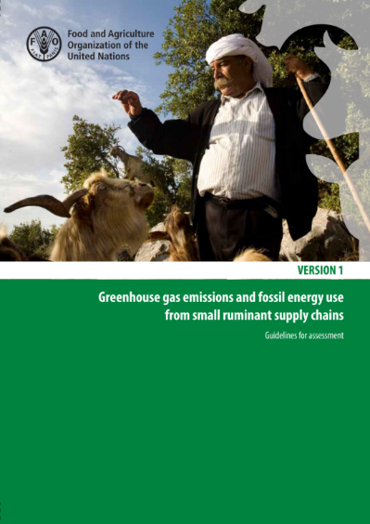
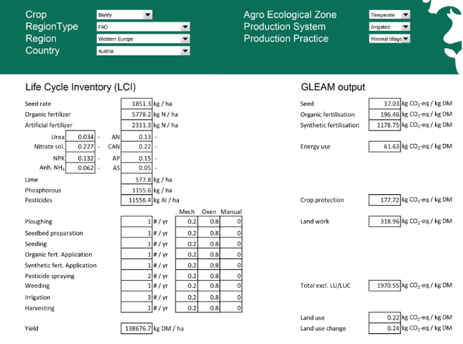
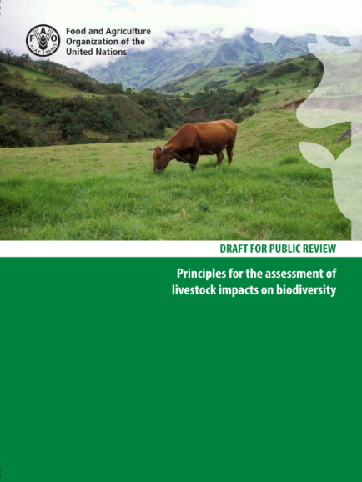
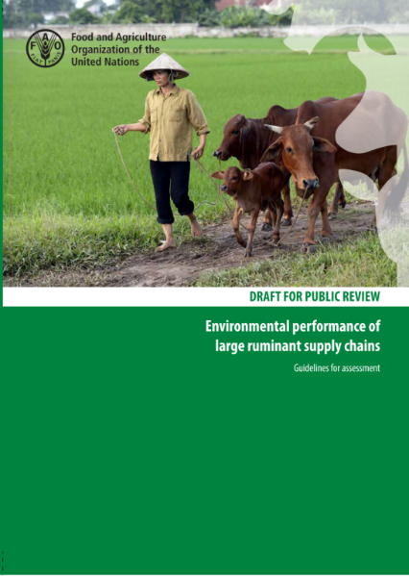
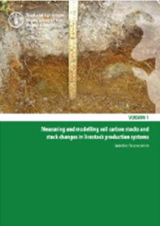
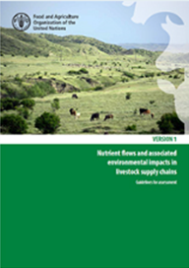
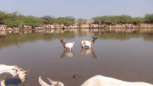
LEAP Achievements
Feed
Poultry
Small Ruminants
Feed Crops Database
Pigs
Biodiversity
Large ruminants
Methodological notes
Soil carbon
Nutrients cycle
Water
Feed Additives
Biodiversity
Notes:
IDF is member of the Global Action for Sustainable Livestock-GASL/FAO and
Livestock Environmental Assessment and Perfomance Partnership- LEAP-FAO contribution in providing methodologies to measure environmental perfomance is critical. IDF is a founder and has been an active participant to that work. New workstream on carbon sequestration and methane.

Slide 23
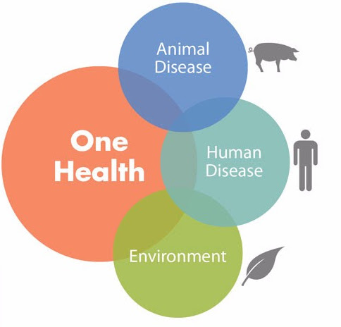
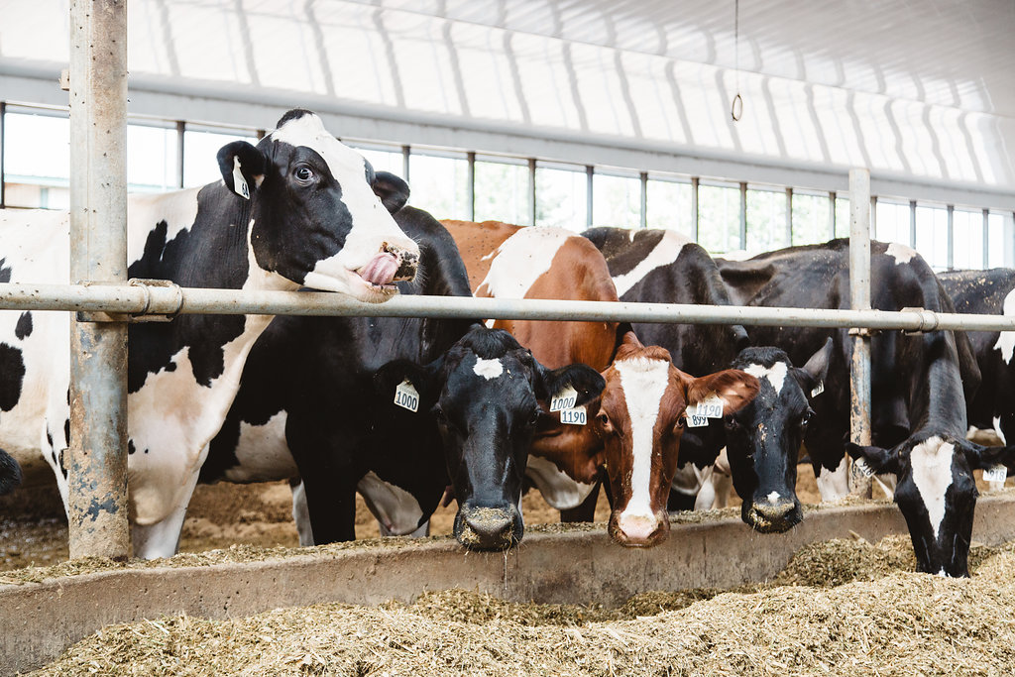
Global key drivers: productive and healthy cattle
One Health
Animal Health and Welfare
Notes:
The last global key driver is productive and healthy cattle.
International governmental organizations such as the FAO, WHO, OIE, Codex are all aligning their work on the ONE Health Approach (which means that there is inter-relations between human health, animal health and the environment). It ensures a coordinated approach on health.
It is then necessary to address animal health and welfare. Not only because we have to but because it also make commercial sense since it improves productivity per animal.
IDF is member of the DISARM project to promote good practices related to use of antibiotics.

Slide 24
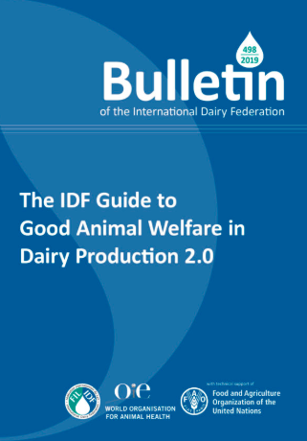
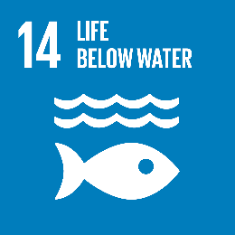

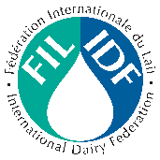


IDF Guidance facilitates Good Animal Welfare Practices
IDF Guide to Good Animal Welfare in Dairy Production 2.0
Implements the current standards of the OIE and the technical specification of ISO on welfare and provides a practical approach for farmers
Notes:
The IDF Guide on Good Animal Welfare implements the current standards of the OIE and the technical specification of ISO on welfare and provides a practical approach for farmers.

Slide 25
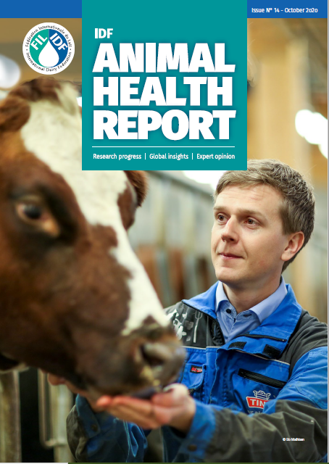
ANIMAL HEALTH AND WELFARE
IDF Animal Health Report n14
17 Articles
Expertise from 11 different countries and 3 international organisations
IDF is member of the DISARM coalition to disseminate innovative solutions for antibiotic resistance (2019-2021)
Notes:
The issue is completed with information on the OIE annual data collection on antimicrobial agents intended for use in animals, a global livestock initiative which includes responses from 153 countries. It offers an opportunity for those involved in the field to share findings of innovative research and provide an update on progress achieved and lessons learned.
Disseminating Innovative Solutions for Antibiotic Resistance (DISARM) 2019-2021
DISARM is a European Commission funded project which sits under the EU’s Horizon 2020 research and innovation programme. It was launched in January 2019 and is a collaboration between farmers, veterinarians, advisory services, academics and industry.
DISARM aims to reduce antibiotic resistance by reducing the need for antibiotics in livestock farming by focusing on disease prevention and prudent use of antibiotics. Antibiotics should be used as little as possible, but as much as necessary to effectively treat disease and not compromise animal welfare.
The network will exchange innovative approaches between industries and countries to share best practice across the whole livestock sector.

Slide 26

Food systems dialogue
In 2021, UN Secretary-General António Guterres will convene a Food Systems Summit to raise global awareness and land global commitments and actions that transform food systems to resolve not only hunger, but to reduce diet-related disease and heal the planet. The Secretary General is calling for collective action of all citizens to radically change the way we produce, process, and consume food.

Slide 27
Food systems Action Tracks
Ensuring access to safe and nutritious food for all (enabling all people to be nourished and healthy, progressive realization of the right to food)
Shifting to sustainable consumption patterns (promoting and creating demand for healthy and sustainable diets, reducing waste)
Boosting nature-positive production at sufficient scale (acting on climate change, reducing emissions and increasing carbon capture, regenerating and protecting critical ecosystems and reducing food loss and energy usage, without undermining health or nutritious diets)
Advancing equitable livelihoods and value distribution (raising incomes, distributing risk, expanding inclusion, promote full and productive employment and decent work for all)
Building resilience to vulnerabilities, shocks and stress (ensuring the continued functionality of healthy and sustainable food systems)

Slide 28
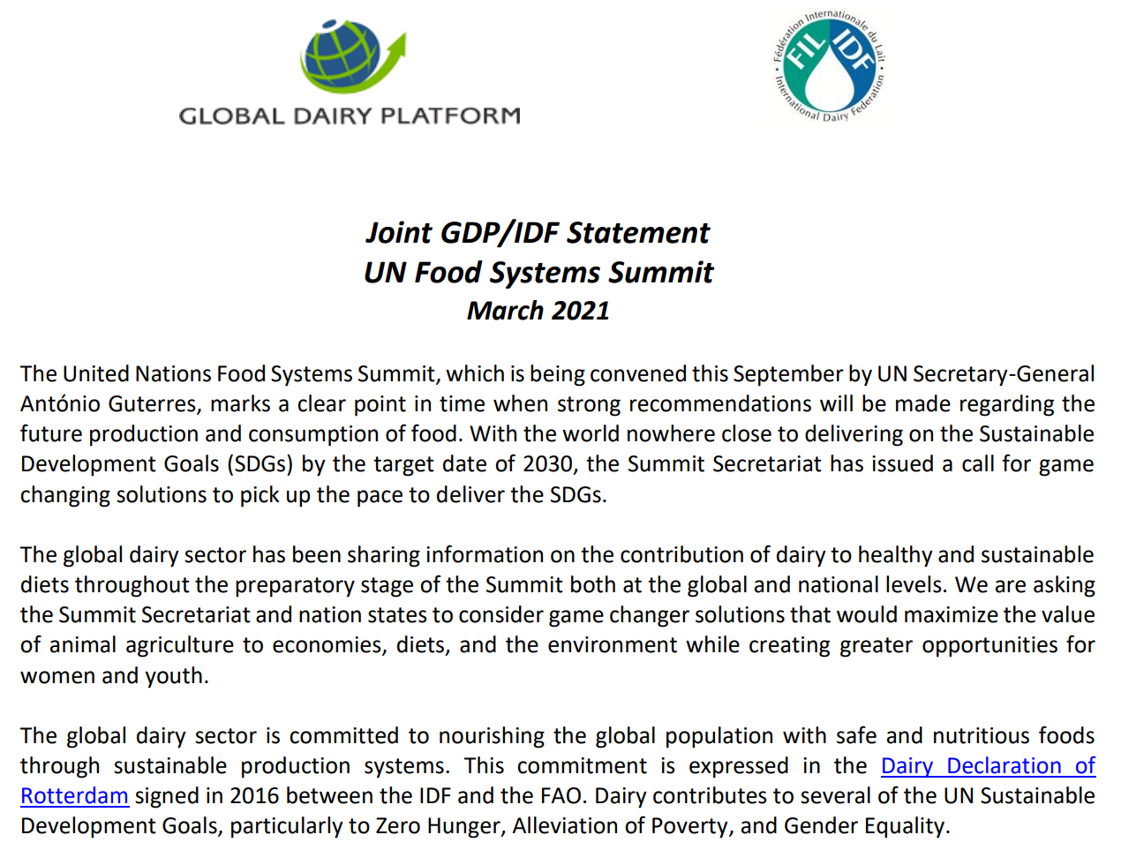
IDF and the UN Food systems Summit
IDF Task Force on Food Systems: strategic plan, key messages, Q&A, statement.
IDF active contribution to CFS guidelines on Nutrition and Food Systems.
IDF and its members participating in food systems dialogues and meetings to promote the role and substantial contribution of dairy in healthy and sustainable diets and food systems.
Blog: UN Food Systems Summit: Game changing solutions for dairy by Dr Judith Bryans, Lead IDF Task Force on FSS
Blog: Dairy as part of the recipe to transition food systems and to achieve the SDG 2030 agenda by Caroline Emond IDF DG

Slide 29
Global Challenges
Social license to operate: environment, animal health & welfare
Food policies on sugar, fat and salt: Front of pack labelling, sugar tax, marketing ban, review of government-issued dietary guidelines
Perception that plant based products are more sustainable
The importance of science based facts in a world of fast and fake news
Notes:
Social license to operate: environment, animal health & welfare
Food policies on sugar, fat and salt: Front of pack labelling, sugar tax, marketing ban, review of government-issued dietary guidelines
Perception that plant based products are more sustainable
The importance of science based facts in a world of social media. Fortunately the pandemic is having a positive impact on the recognition of the essential role of science and trust for scientists. We have been competing in the last years in a world where there is overwhelming level of information in and environment of fast news, opinions versus facts, emotions, political influence. Even in the decision-making sphere we here so calls to move from science-based to evidence-based and even to recognize traditional knowledge.
What is science? What science is acceptable?

Slide 30
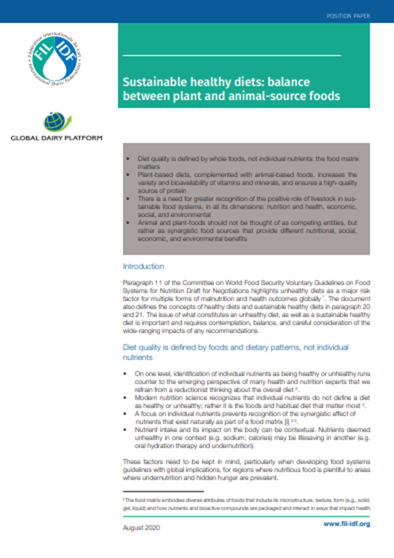
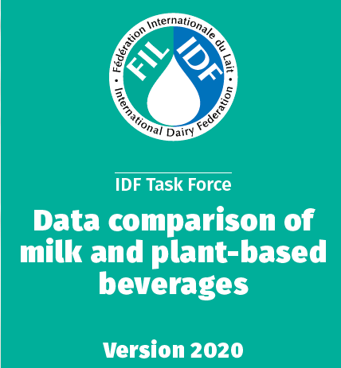
Notes:
Diet quality is defined by whole foods, not individual nutrients: the food matrix matters
Plant-based diets, complemented with animal-based foods, increases the variety and bioavailability of vitamins and minerals, and ensures a high-quality source of protein
There is a need for greater recognition of the positive role of livestock in sustainable food systems, in all its dimensions: nutrition and health, economic, social, and environmental
Animal and plant-foods should not be thought of as competing entities, but rather as synergistic food sources that provide different nutritional, social, economic, and environmental benefits

Slide 31

Joint statement GDP-IDF on plant based
Diet quality is defined by whole foods, not individual nutrients: the food matrix matters
Plant-based diets, complemented with animal-based foods, increases the variety and bioavailability of vitamins and minerals, and ensures a high-quality source of protein
There is a need for greater recognition of the positive role of livestock in sustainable food systems, in all its dimensions: nutrition and health, economic, social, and environmental
Animal and plant-foods should not be thought of as competing entities, but rather as synergistic food sources that provide different nutritional, social, economic, and environmental benefits

Slide 32
Global Opportunities
Promote the role of dairy in healthy diets produced in a sustainable manner and the contribution of dairy to the UN SDGs. E.g. UN Food Systems Summit.
Continue to support research and innovation and promote the science behind dairy.
Provide knowledge and expertise to IGO such as Codex and OIE and regulators.
Contribute to the work of IDF thru IDF National Committee Russia.
Notes:
Promote the role of dairy in healthy diets produced in a sustainable manner and the contribution of dairy to the UN SDGs. E.g. UN Food Systems Summit.
Continue to support research and innovation and promote the science behind dairy.
Provide knowledge and expertise to IGO such as Codex and OIE and regulators.
Contribute to the work of IDF.

Slide 33
Conclusions
The global dairy sector is:
expanding (or prospering), due to population and per capita consumption growth
key to global nutrition and food security
significant contributors to achieve the UN SDGs
dynamic and resilient
Dairy is part of healthy and sustainable diets.

Slide 34
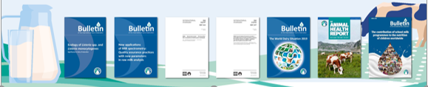
Idf programme of work delivered 2020
5 Bulletins
The World Dairy Situation 2019
Ecology of Listeria in Dairy Production
Global Marketing Trends, Understanding changes in dairy consumption around the world
Applications of MIR spectrometry: Quality assurance practices
The contribution of school milk programmes to the nutrition of children worldwide – Edition 2020
6 Joint IDF/ISO standards
27 submissions to IGOs
8 Position papers
Impacts of COVID-19 on food security and nutrition:
Lactose, an important nutrient
Sustainable healthy diets: balance between plant and animal-source foods
Front of Pack Nutrition Labelling - Delivering meaningful public health outcomes
Nutrition Profiling Models:
3 reports
IDF Dairy Sustainability Outlook
IDF Animal Health Report
IDF Animal Health Report
7 Factsheets
Reproductive Technology
Dairy’s role in supporting a healthy immune system
Lactose
Technical Webinars
Between April and November 2020, we organized 24 webinars on a broad range of topics for IDF experts.
Notes:
IDF produces: Bulletins, Reports, Fact sheets, Position Papers, Submissions to IGOs, IDF-ISO standards and IDF Technical Webinars Series.

Slide 35
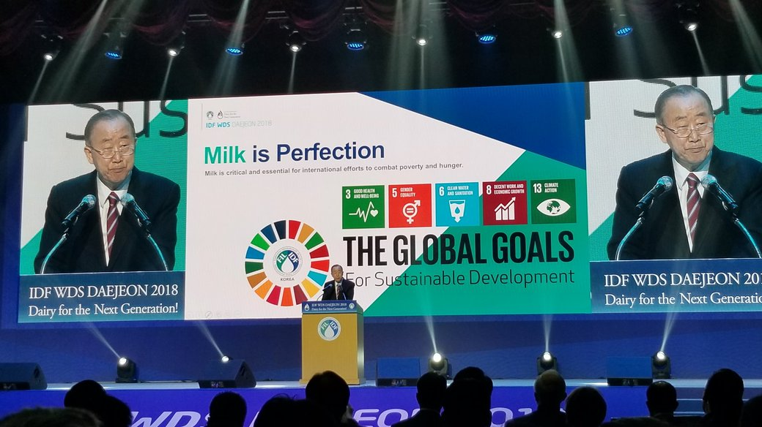
Notes:
The former UN Secretary-General of the United Nations Ban Ki Moon said it well at the IDF World Dairy Summit in Korea in 2018: Milk is perfection! He acknowledged that dairy contributes to several UN Sustainable Development Goals. “The dairy sector plays a leading role in international efforts to achieve the Sustainable Development Goals which are aimed at socio-economic transformation to eradicate poverty and hunger, and to construct a sustainable world where humanity can enjoy better education, healthcare, and equality.”
The Global Story of the Dairy Sector is strong!

Slide 36
